Slide 1



SISTEM INFORMASI KARYAWAN
IDEA IMAJI PERSADA
IT Intern ‘19
PT Idea Imaji Persada

Slide 2
01
WHY DON’T WE USE THE CURRENT SYSTEM?

Slide 3
Here’s the problem
Data Karyawan
Data Presensi
Kalkulasi Gaji
Perizinan

Slide 4
SOLUTION ?

Slide 5
S I K I I P
Sistem Informasi Karyawan Idea Imaji Persada

Slide 6
02
WHAT CAN SIKIIP DO?

Slide 7
Activity Diagram

Slide 8
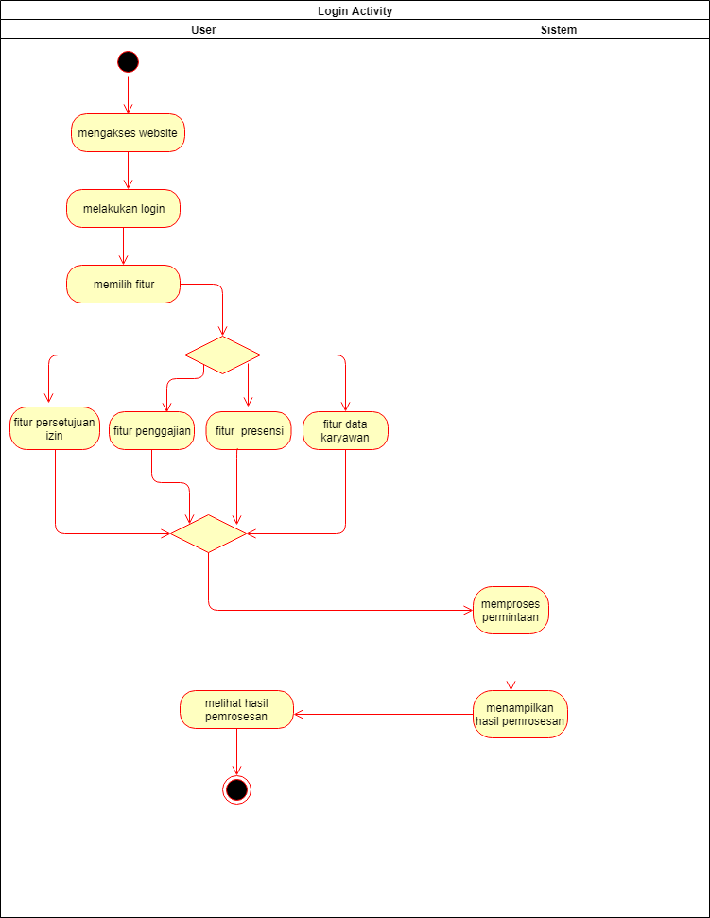
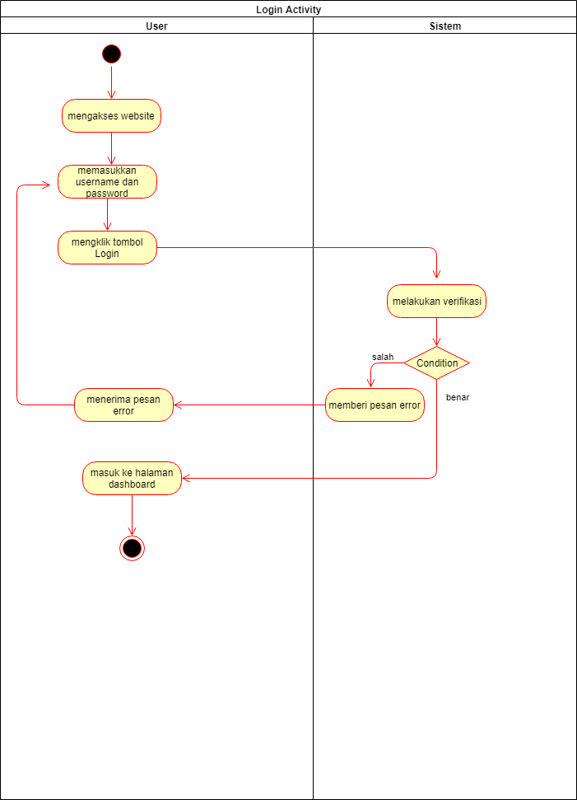
Activity Diagram
Login
Beranda

Slide 9
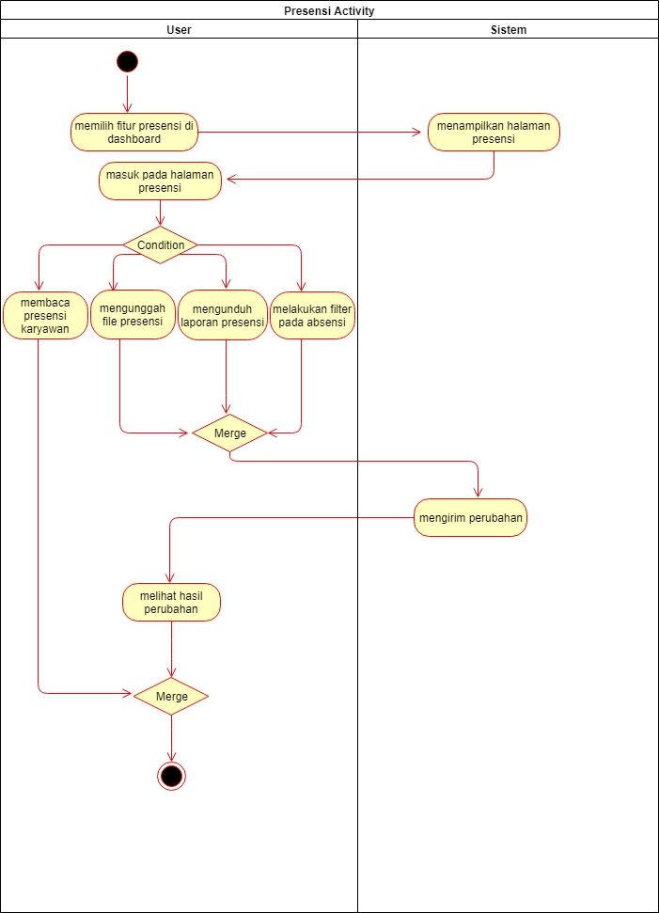
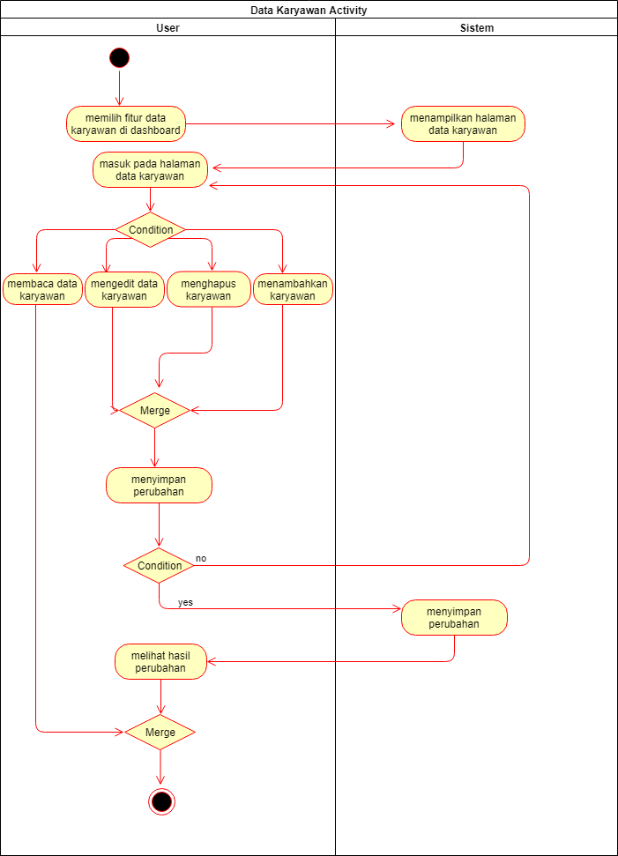
Activity Diagram
Data karyawan
Presensi

Slide 10
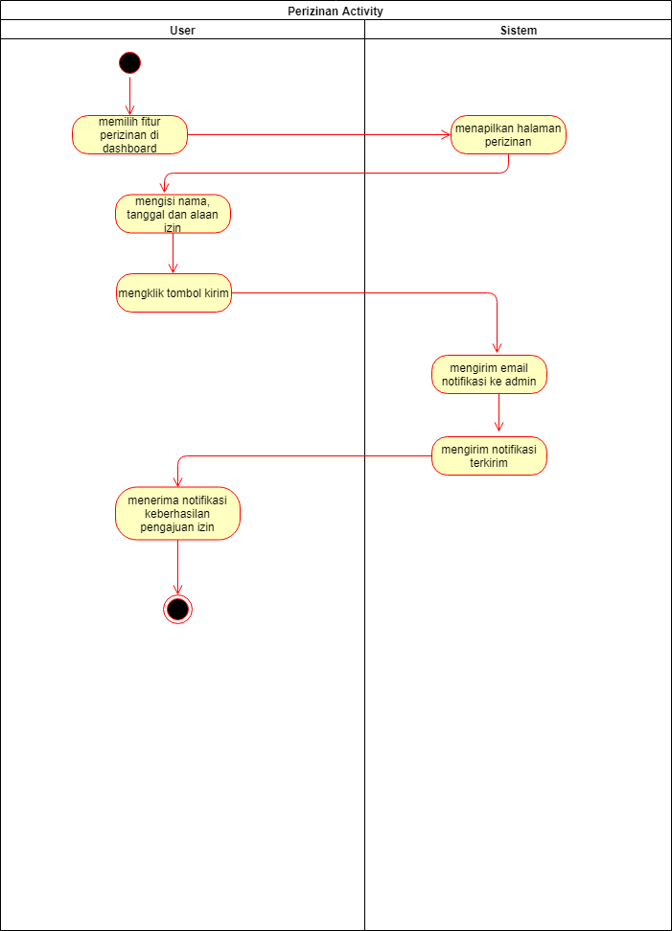
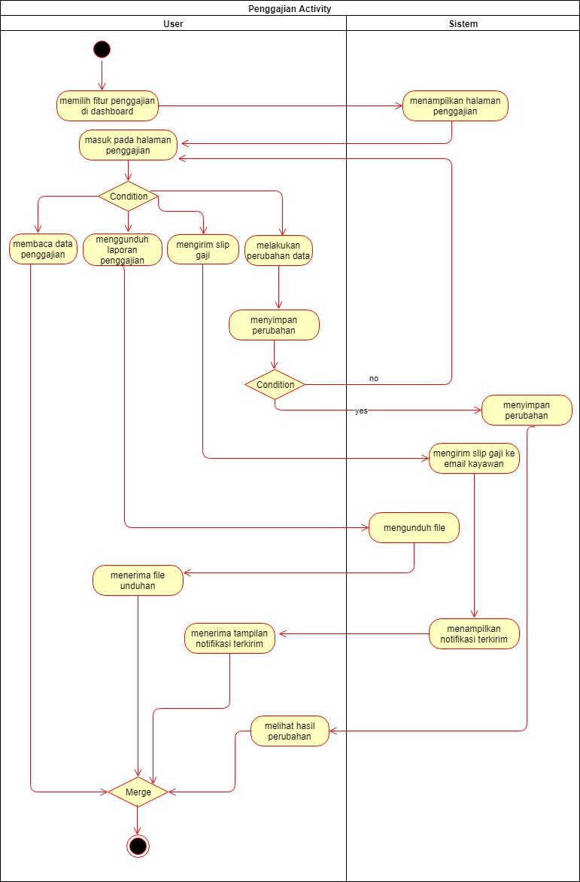
Activity Diagram
Penggajian
Perizinan

Slide 11
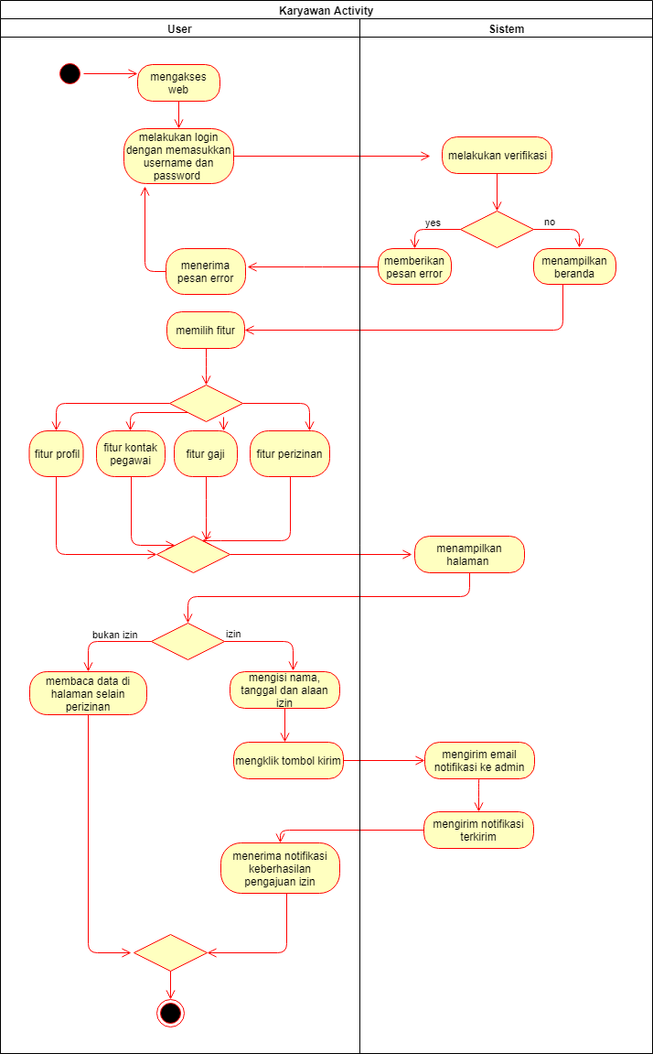
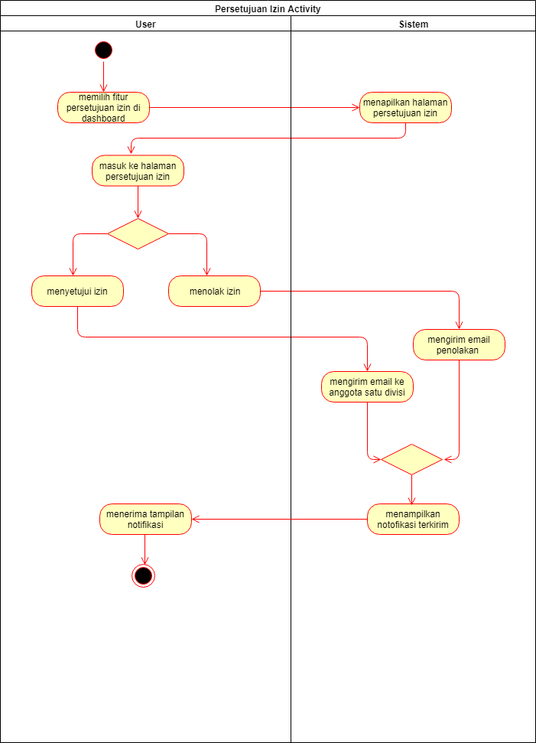
Activity Diagram
Persetujuan izin
Karyawan

Slide 12
Entity Relationship Diagram

Slide 13
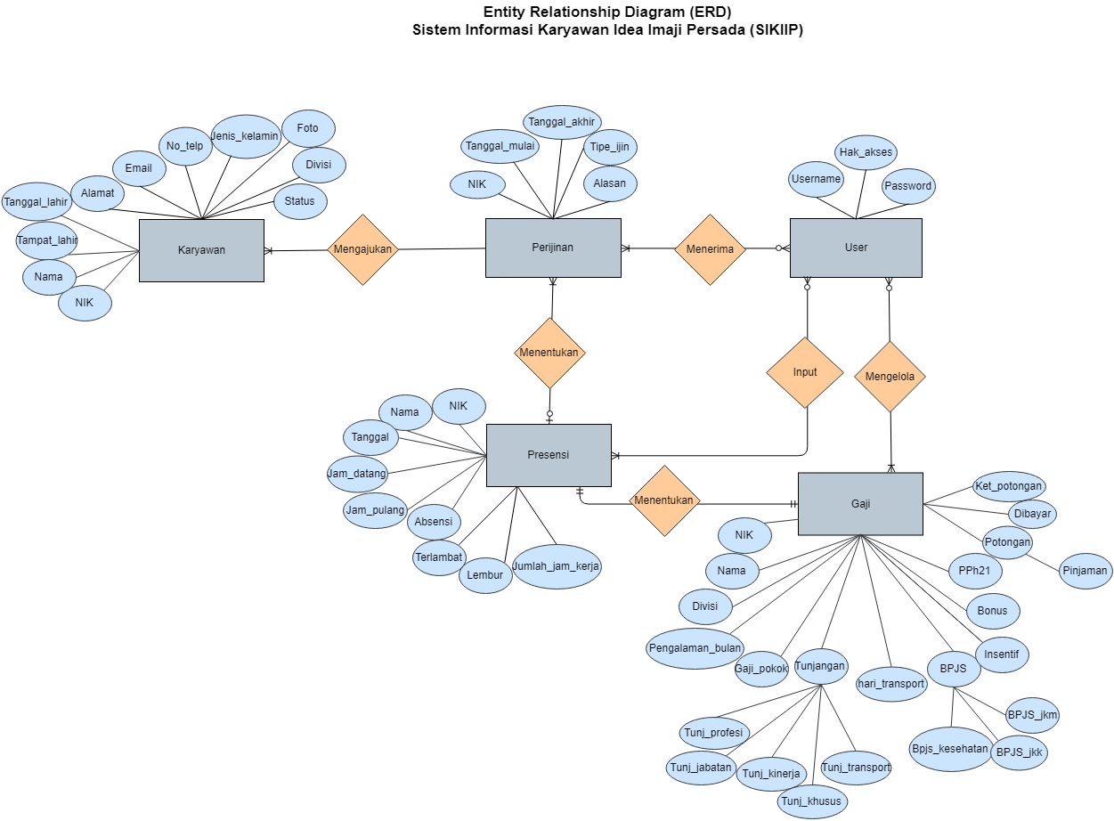

Slide 14
Class Diagram

Slide 15
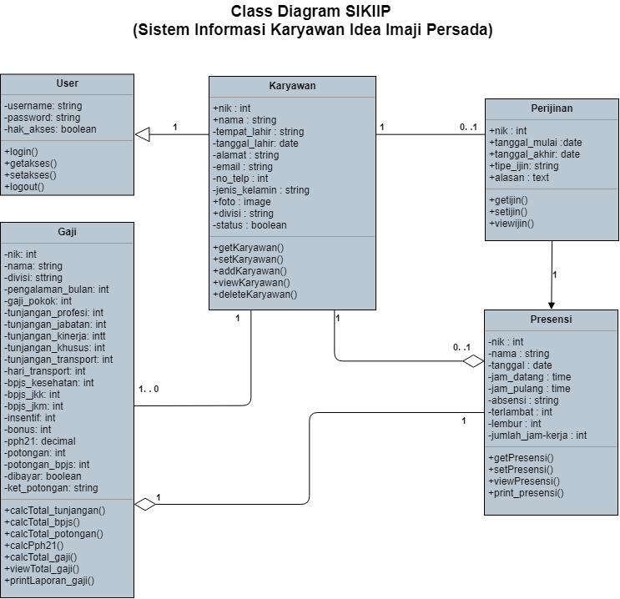

Slide 16
03
WIREFRAME

Slide 17
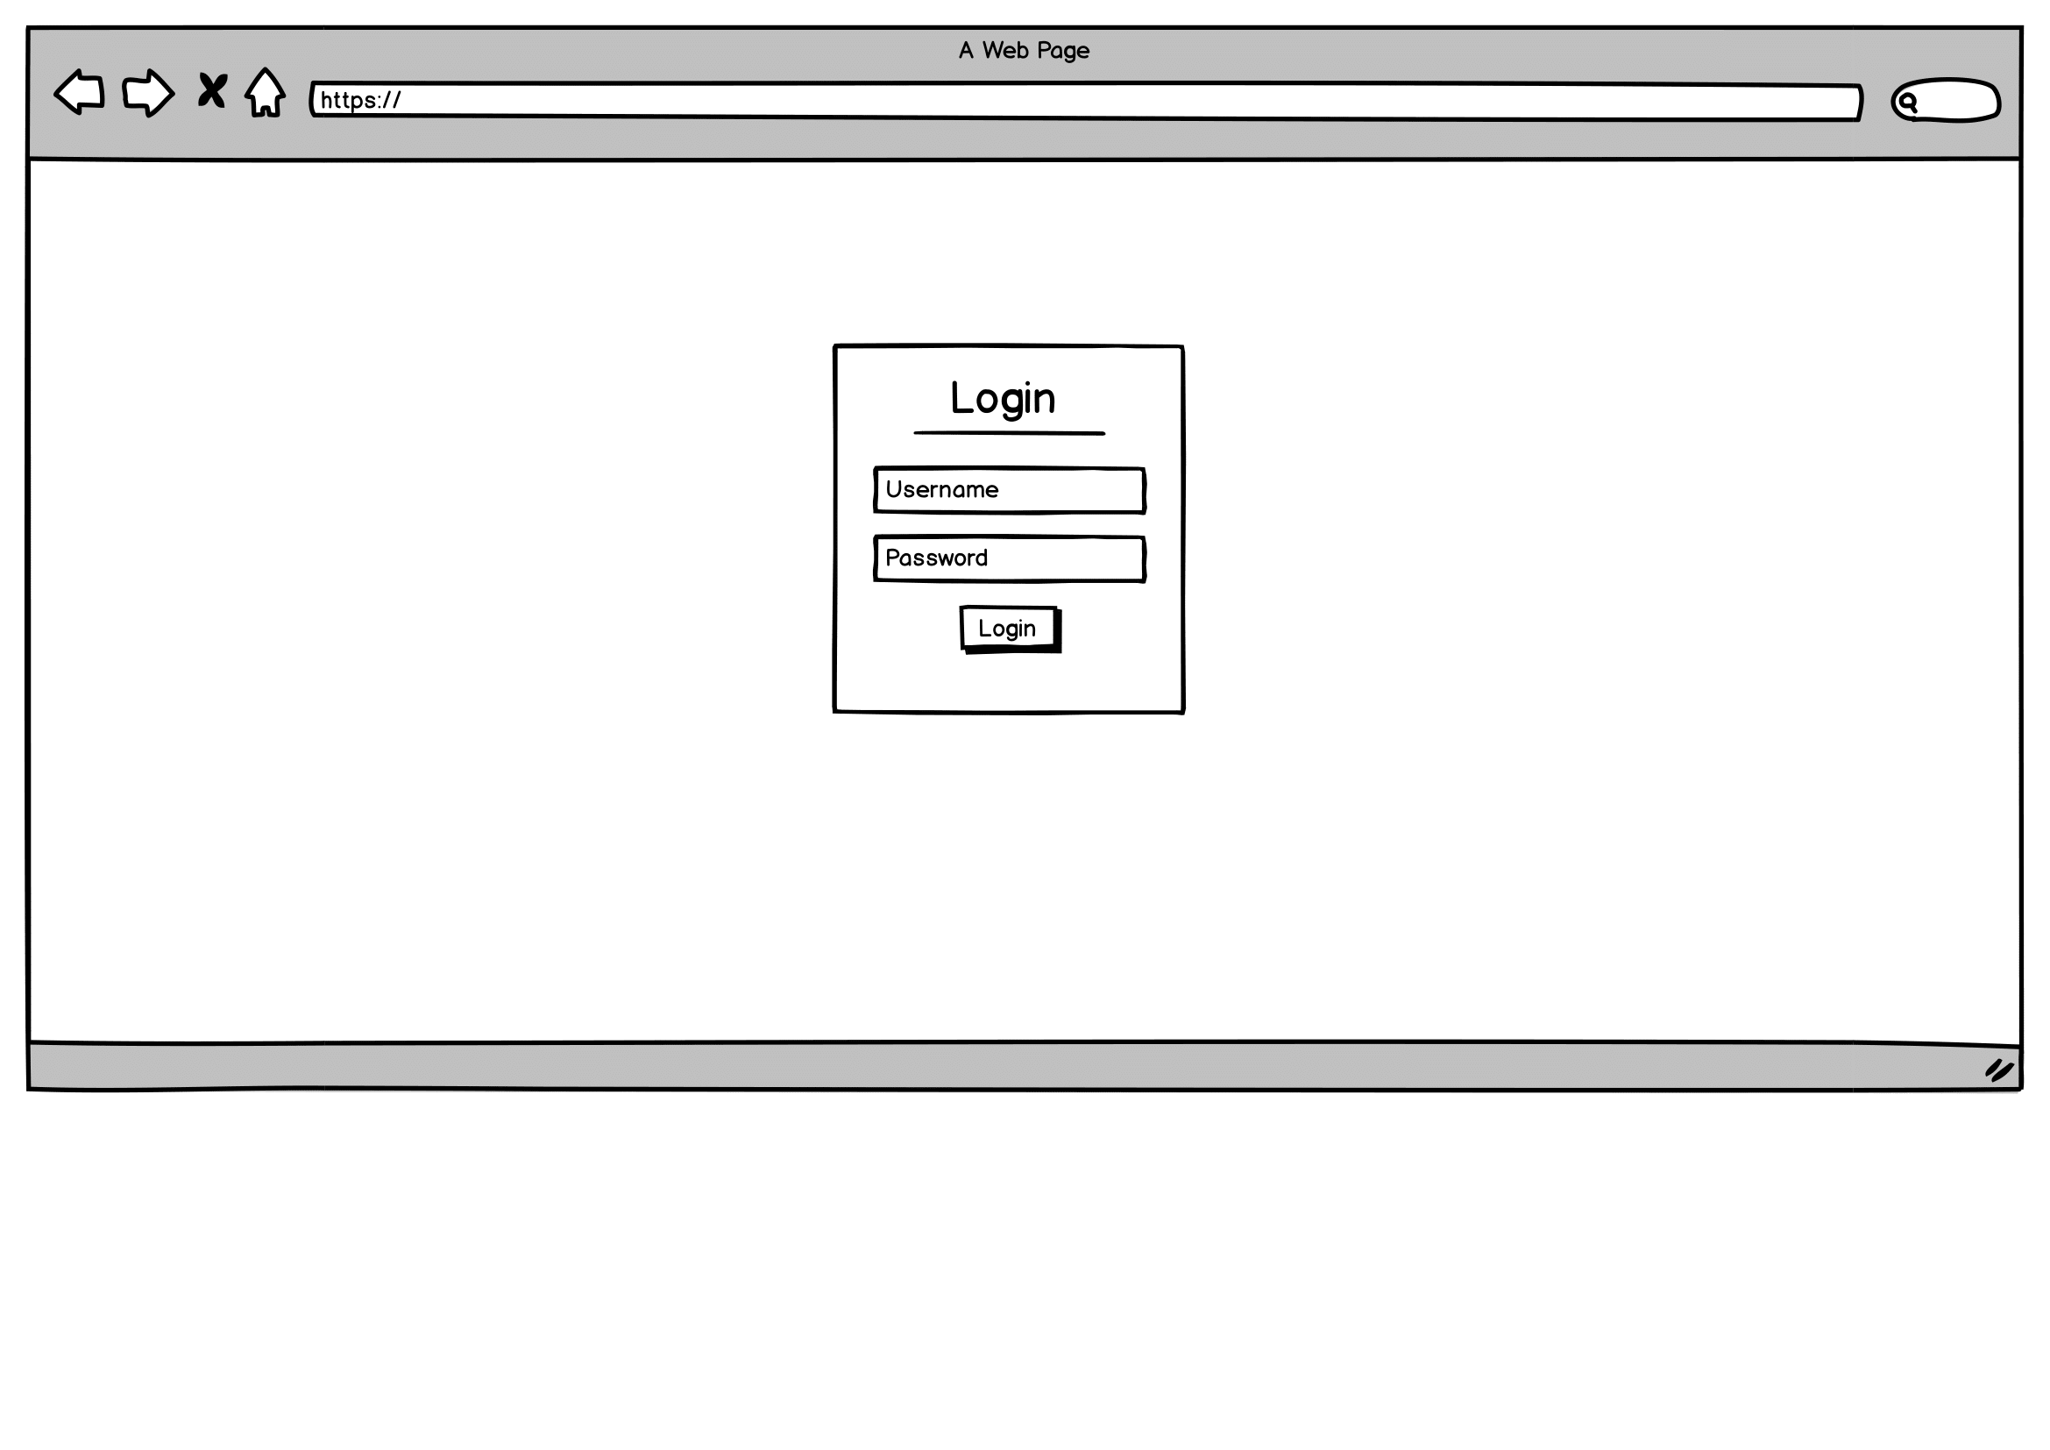
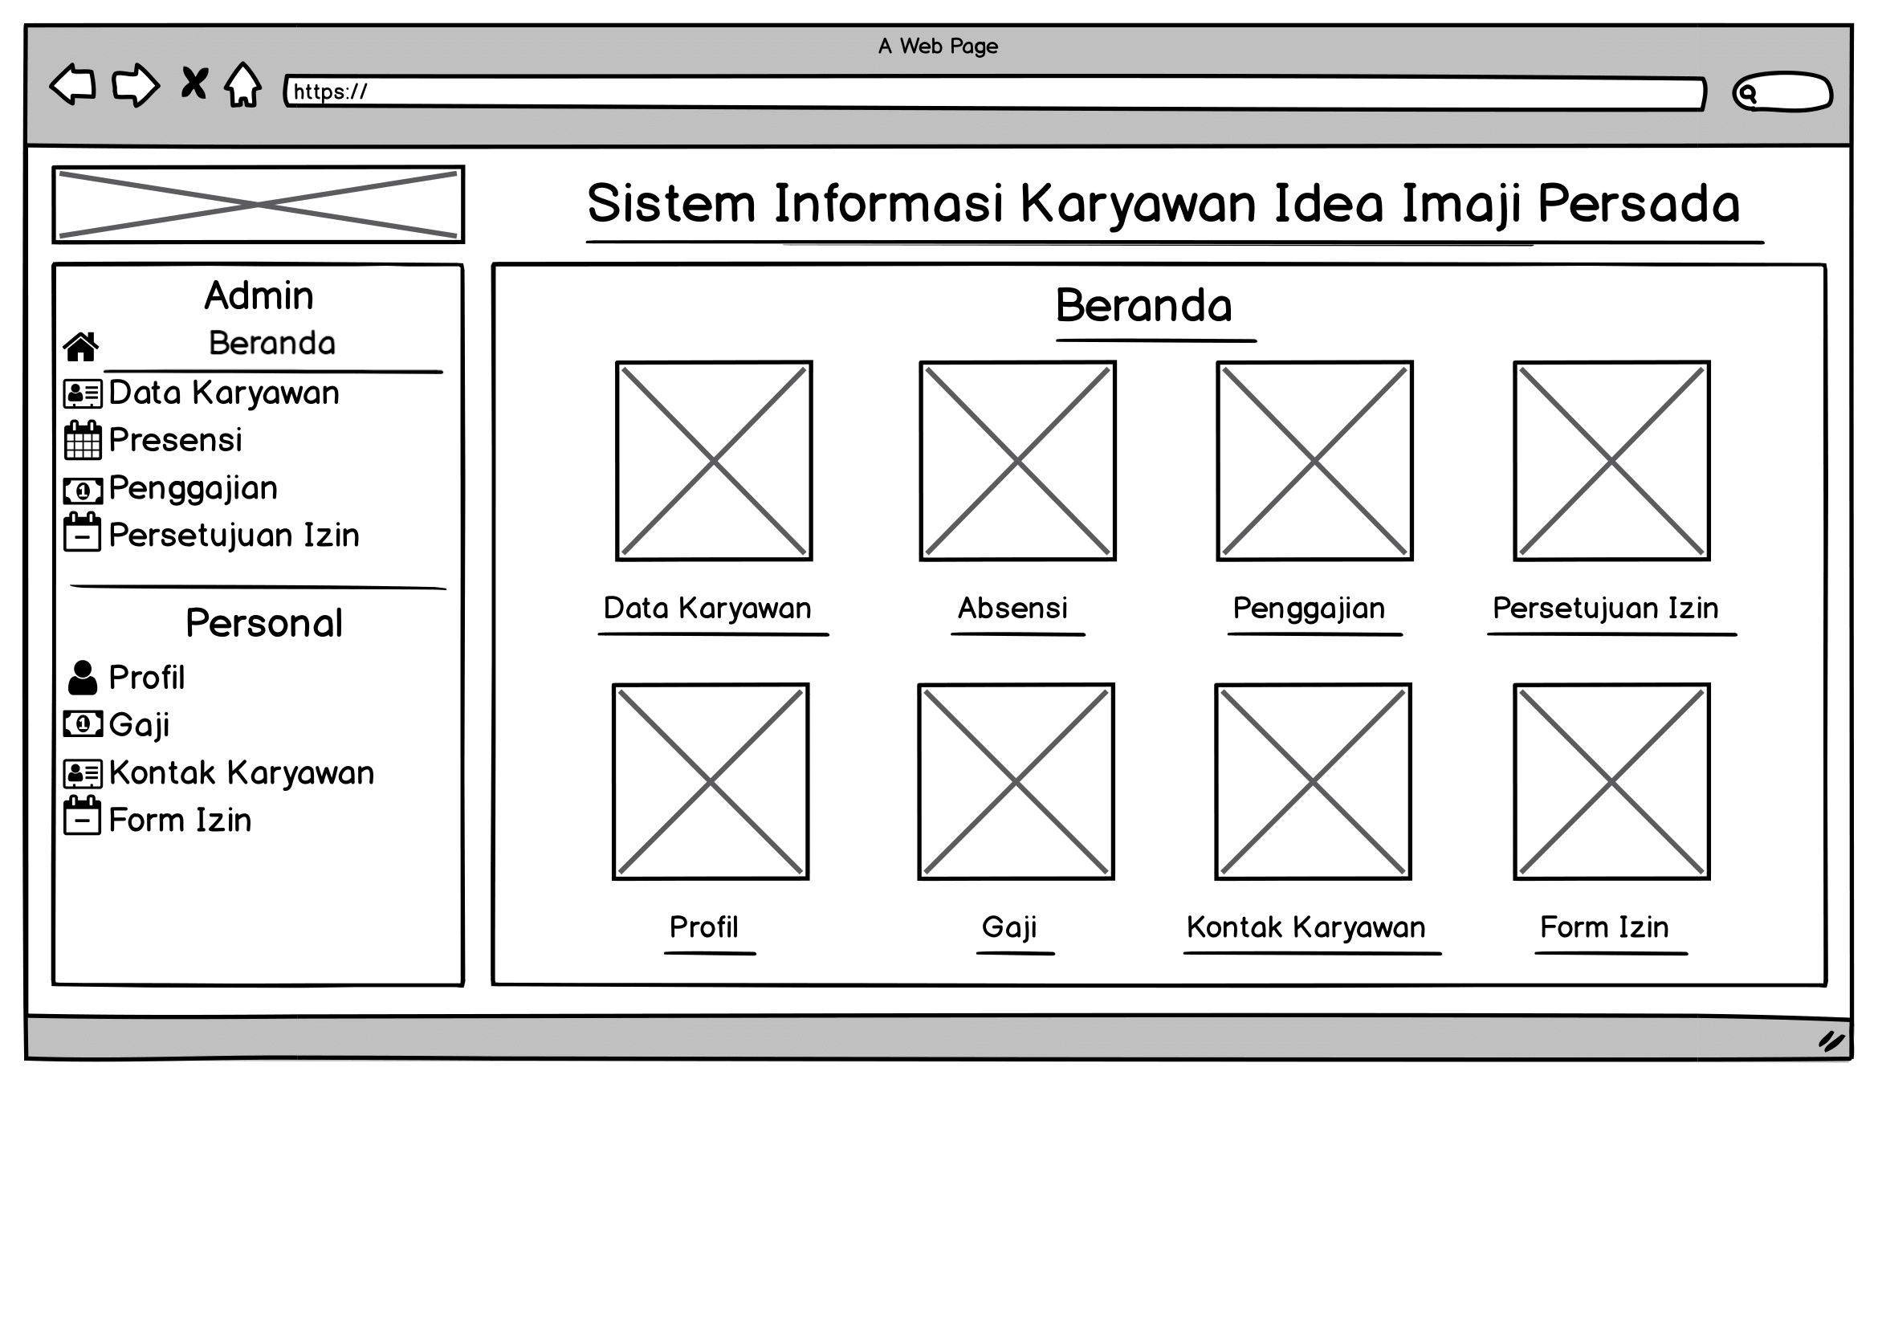
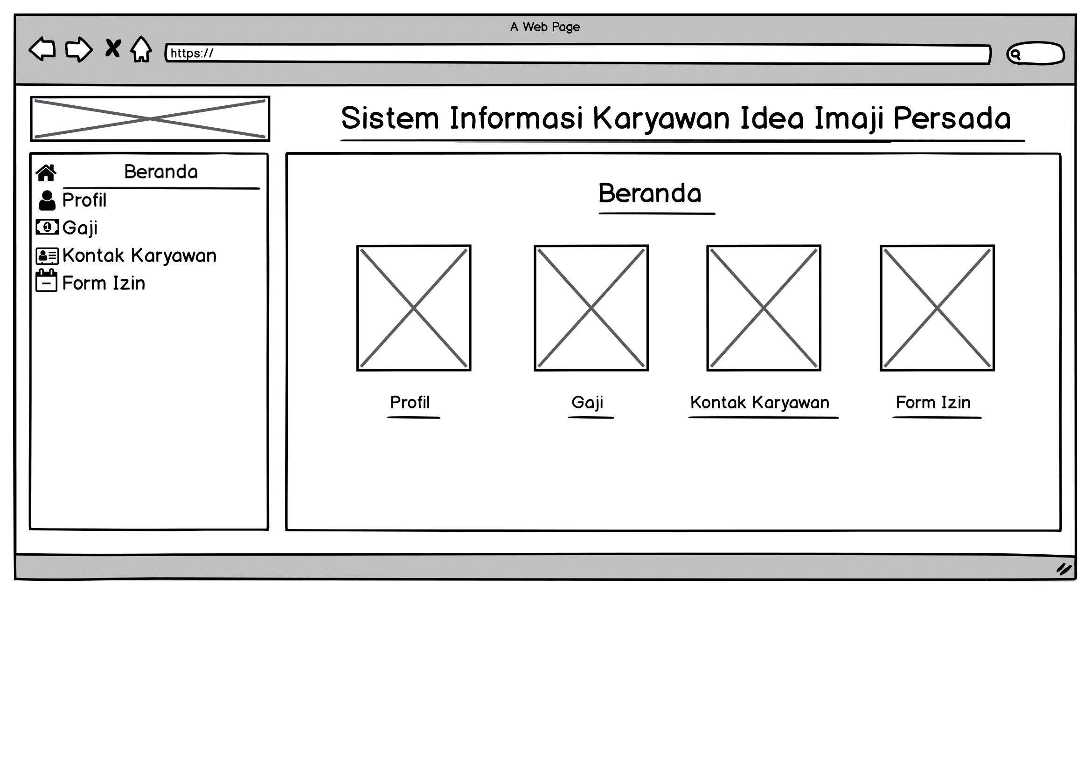
Beranda Admin
Login
Beranda Karyawan

Slide 18
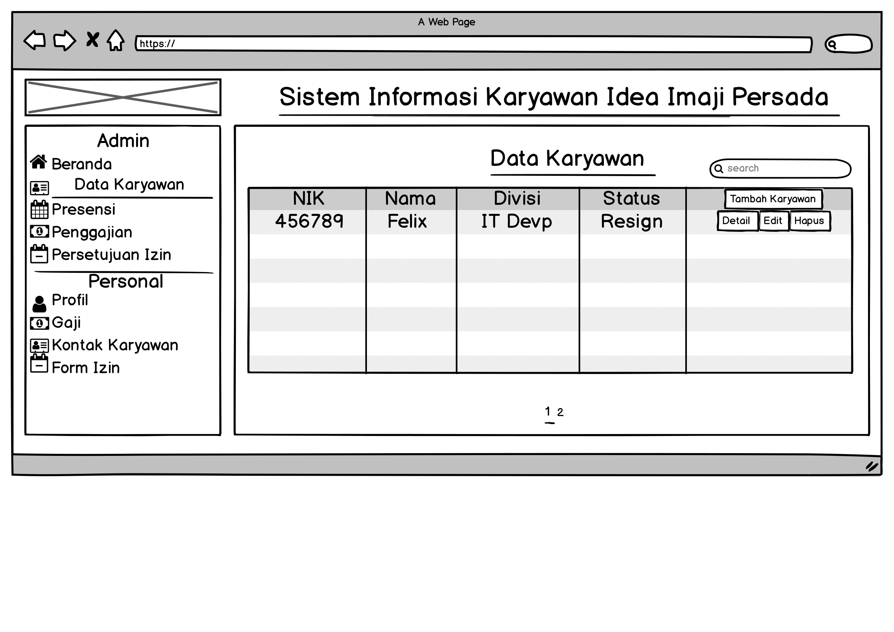
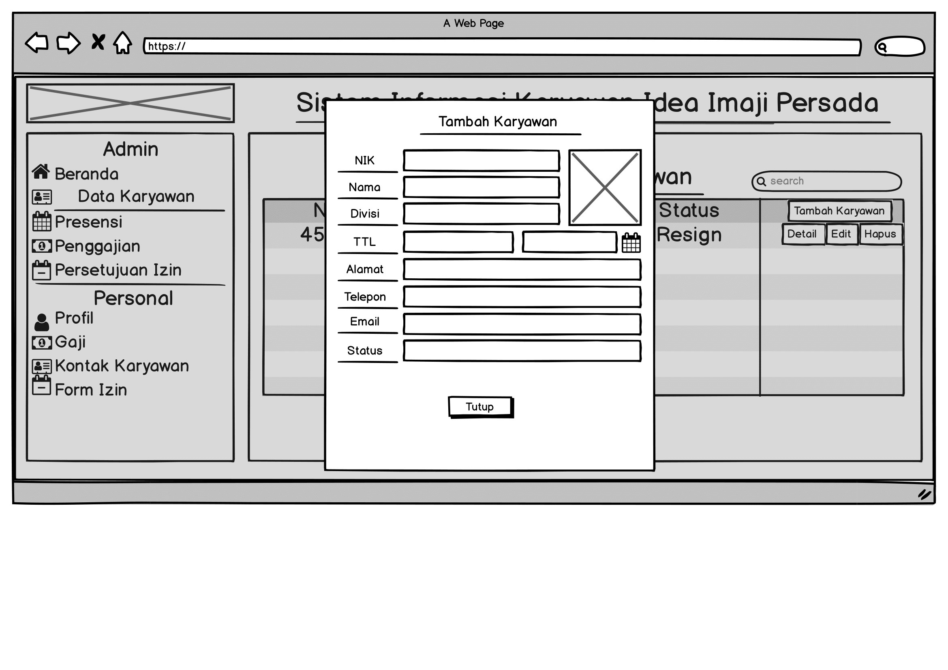
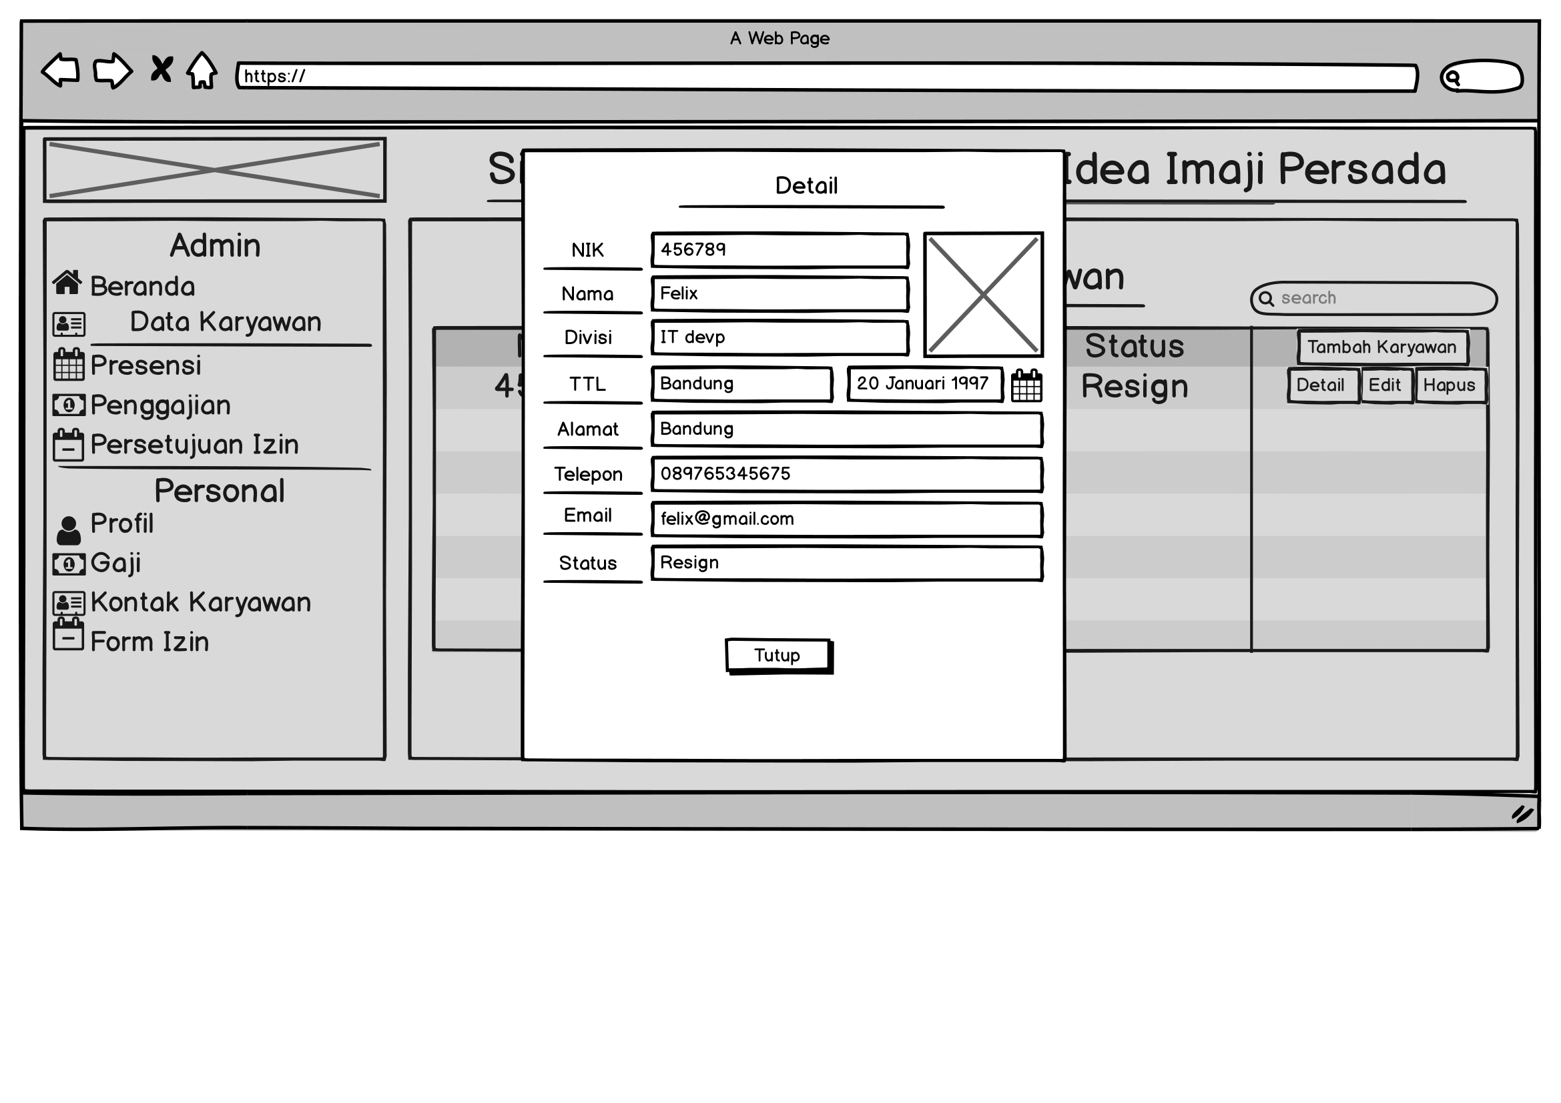
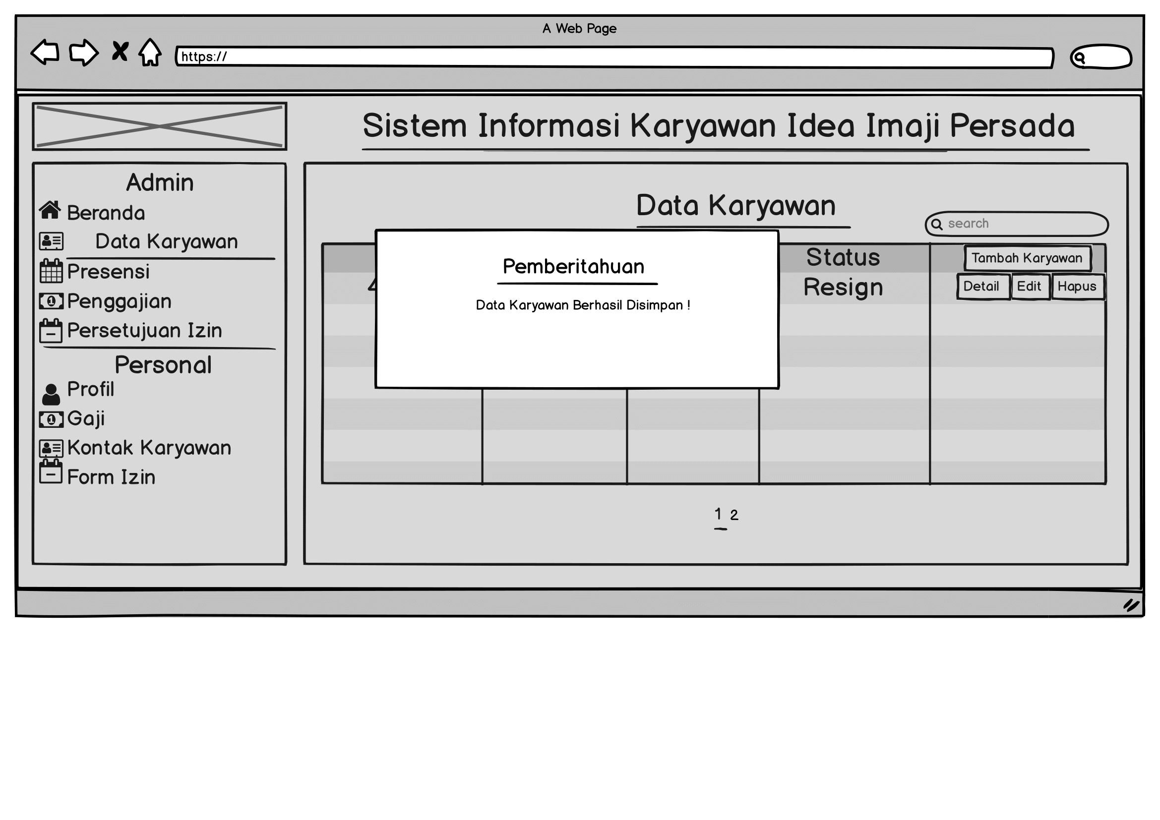
Data Karyawan

Slide 19
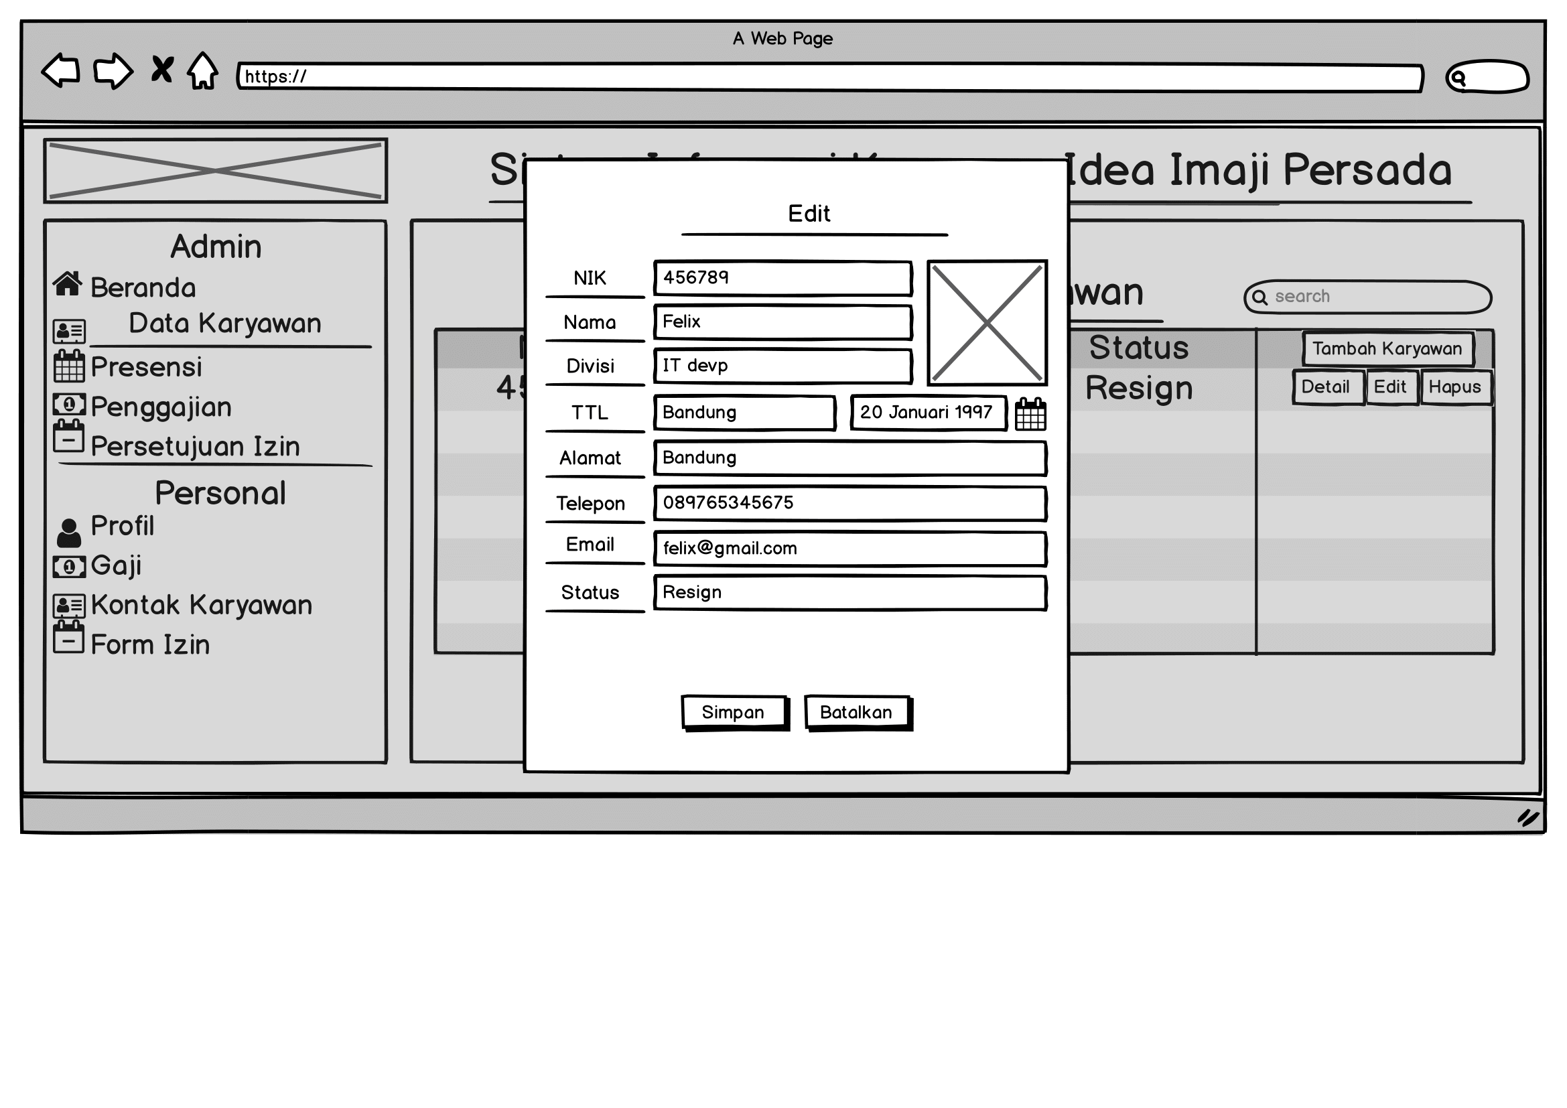
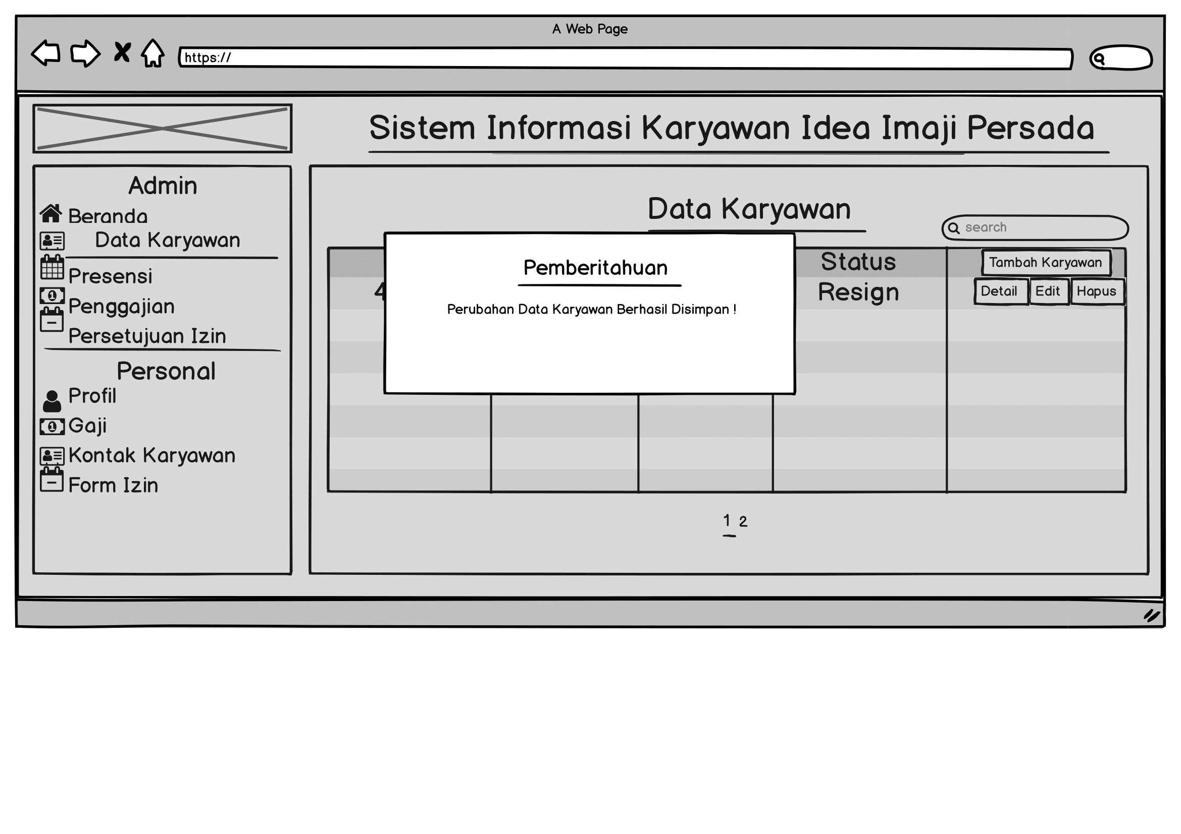
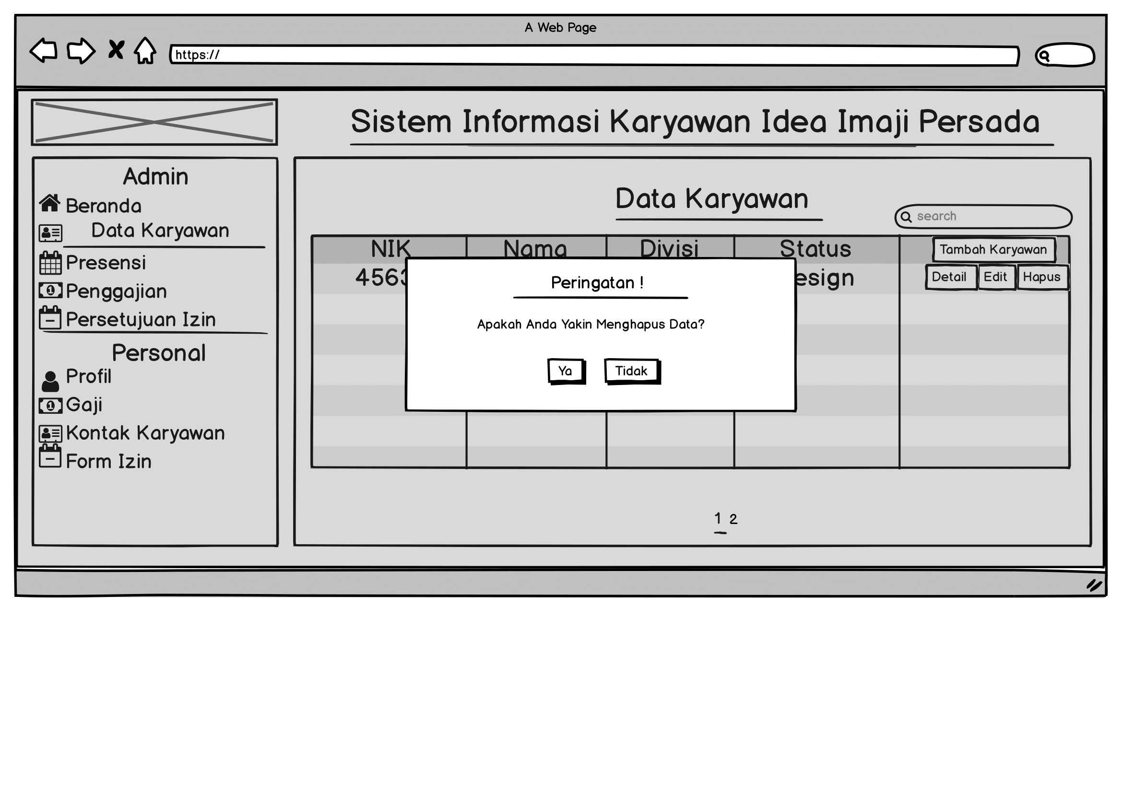
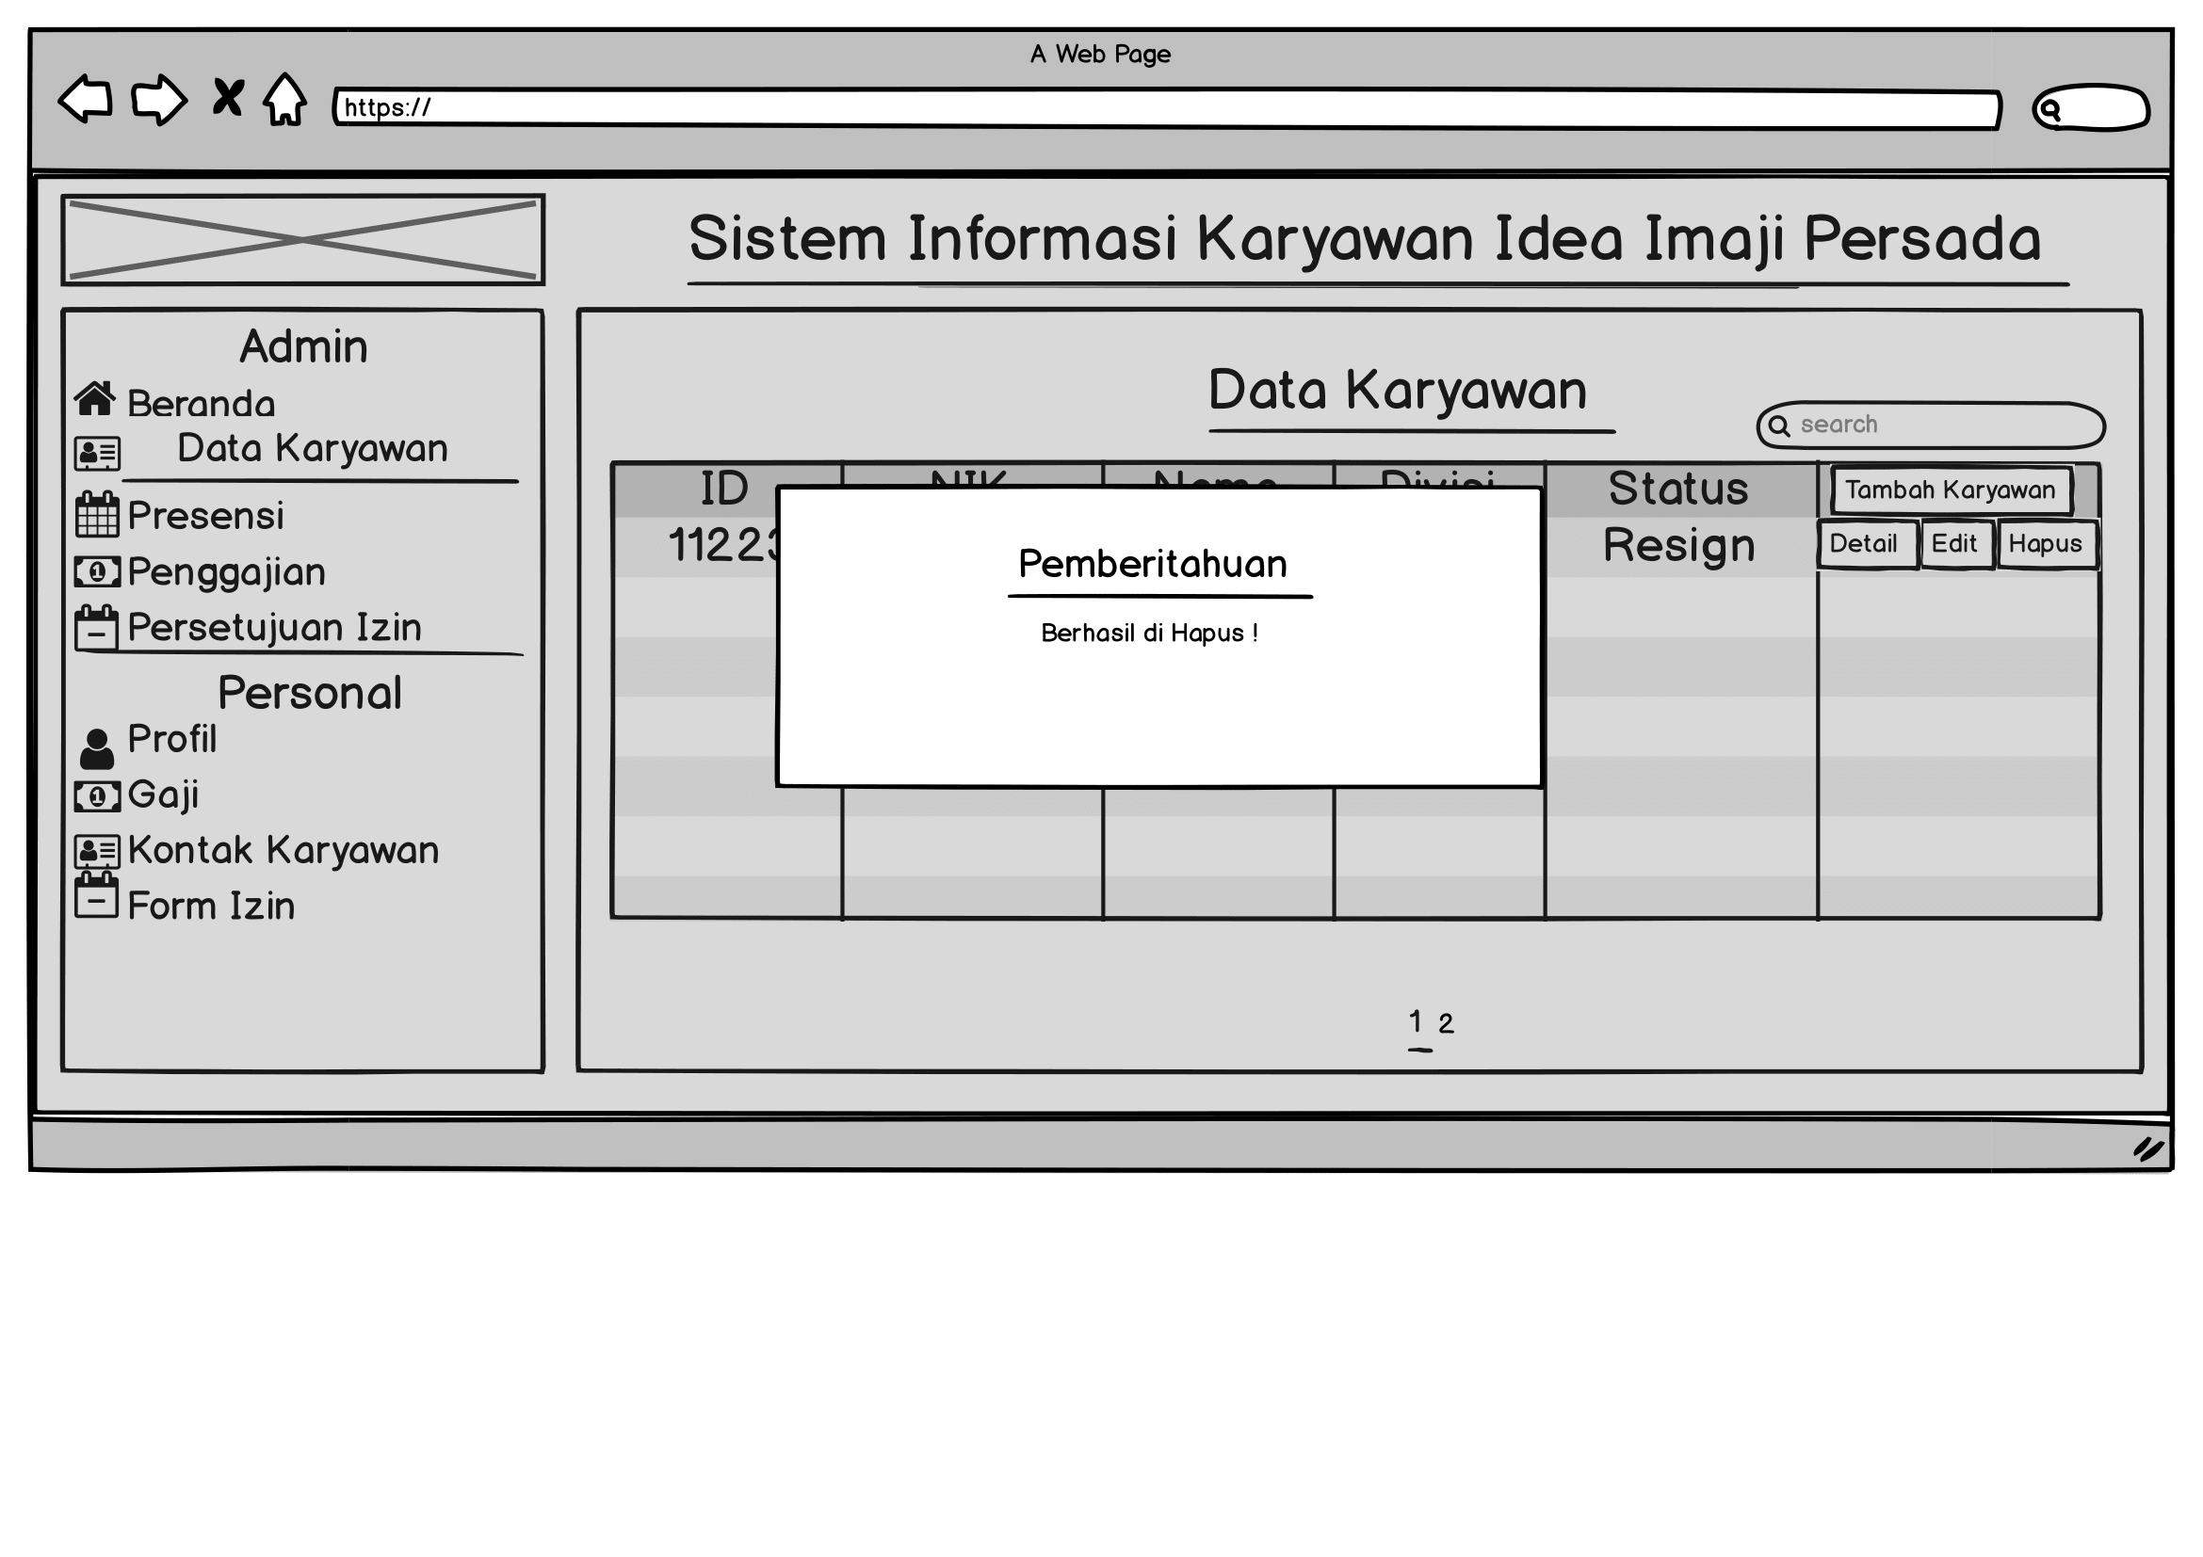
Data Karyawan (2)

Slide 20
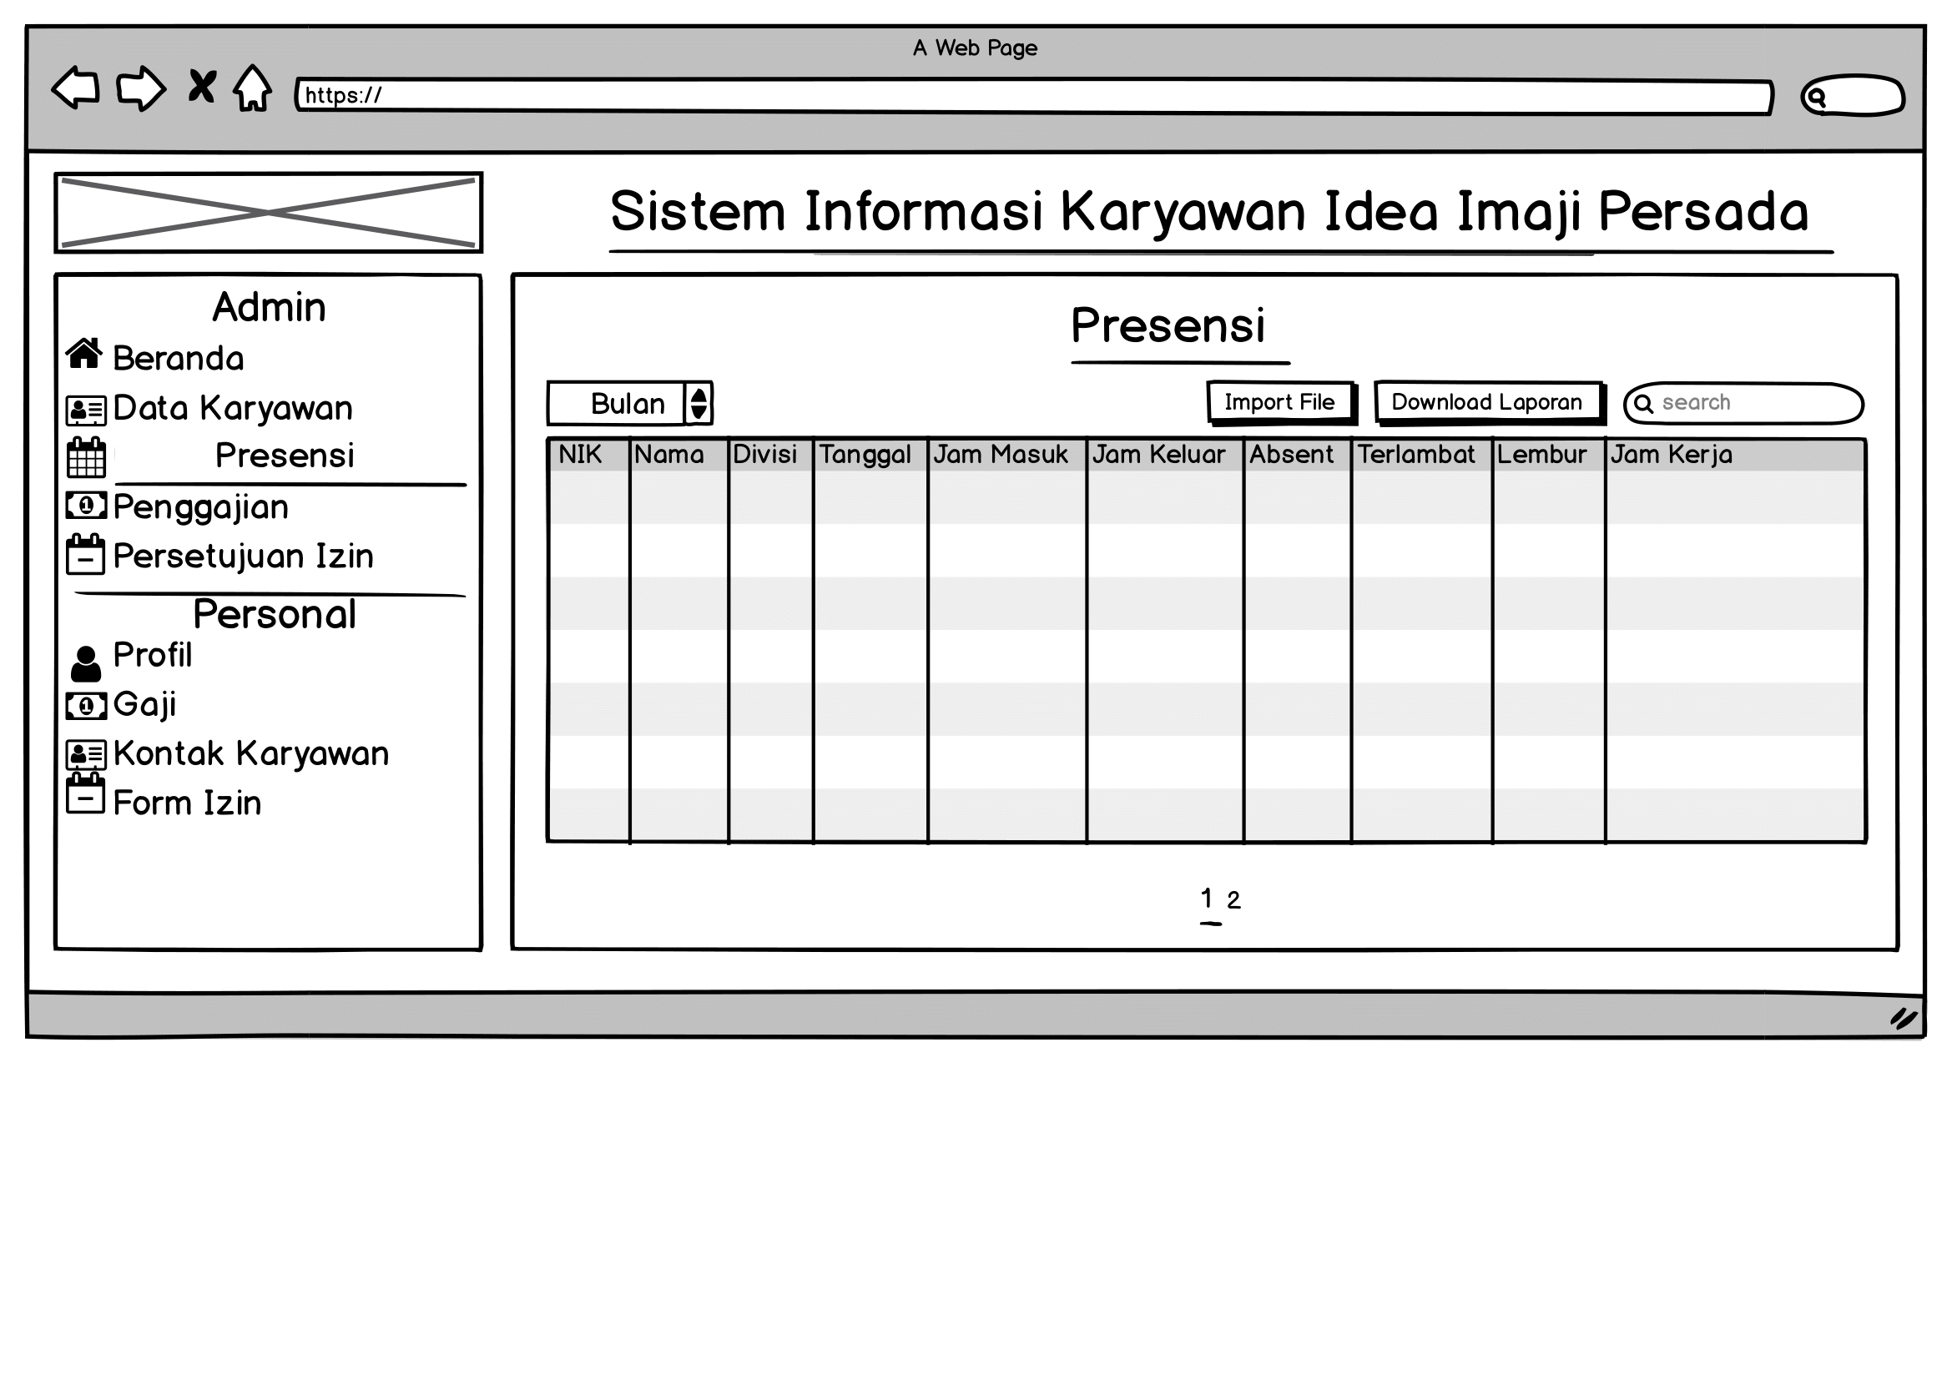
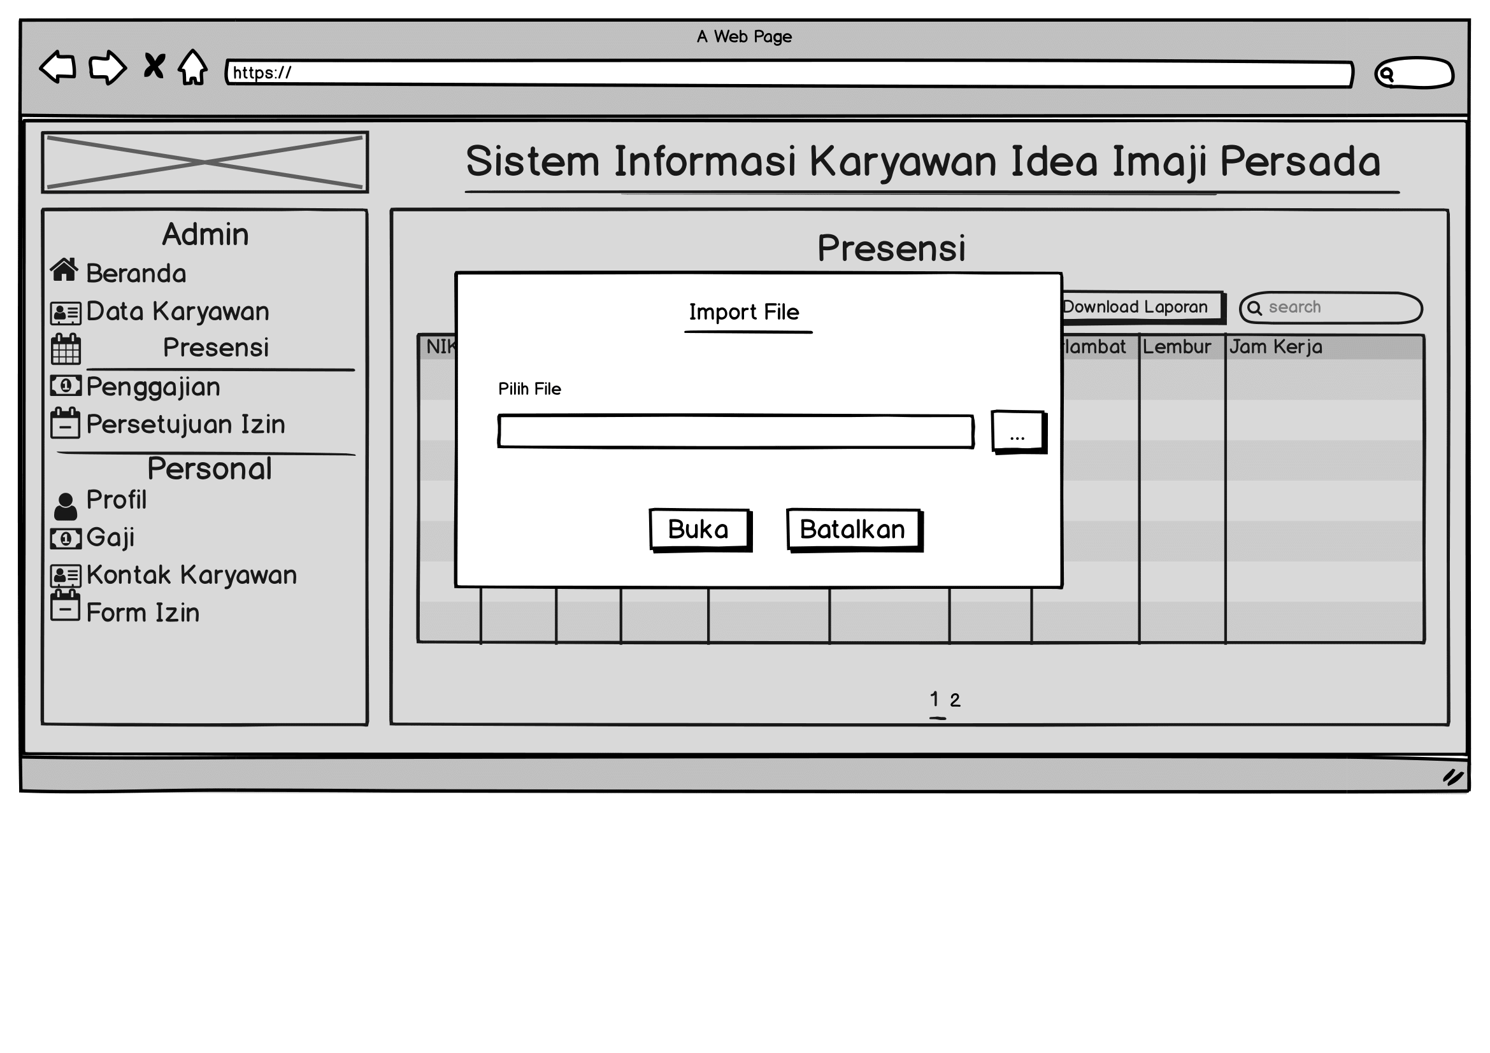
Presensi

Slide 21
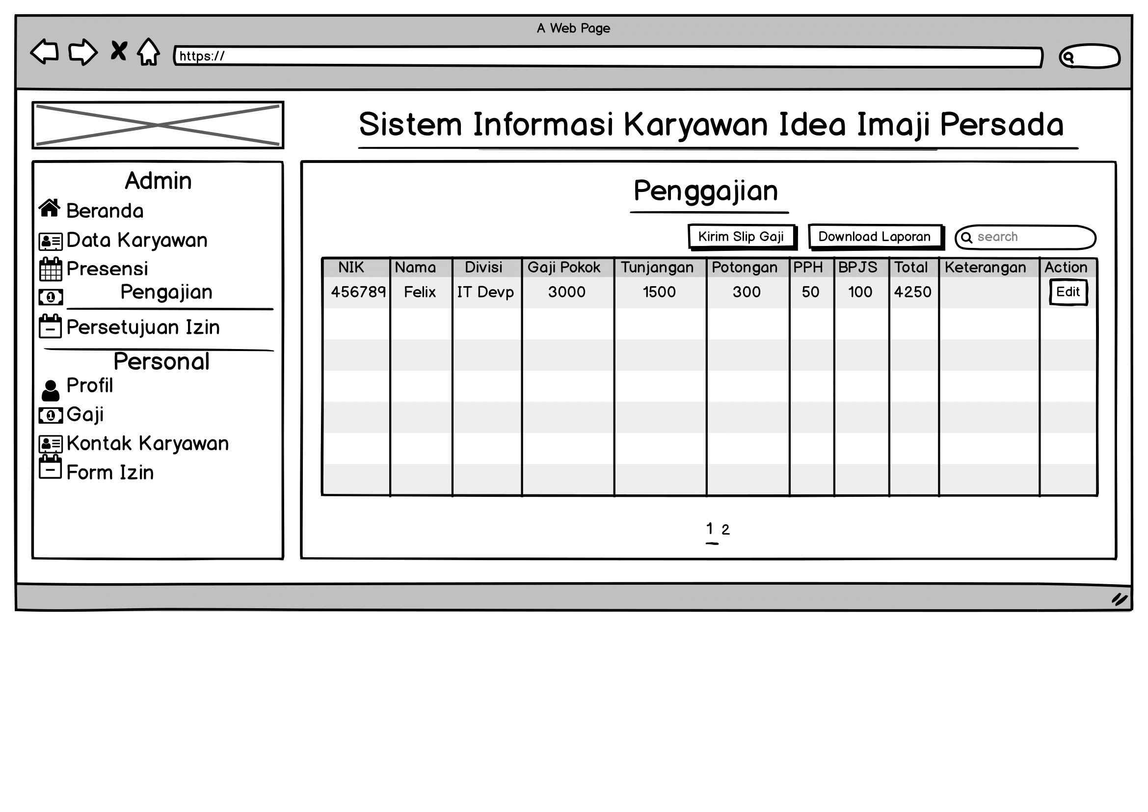
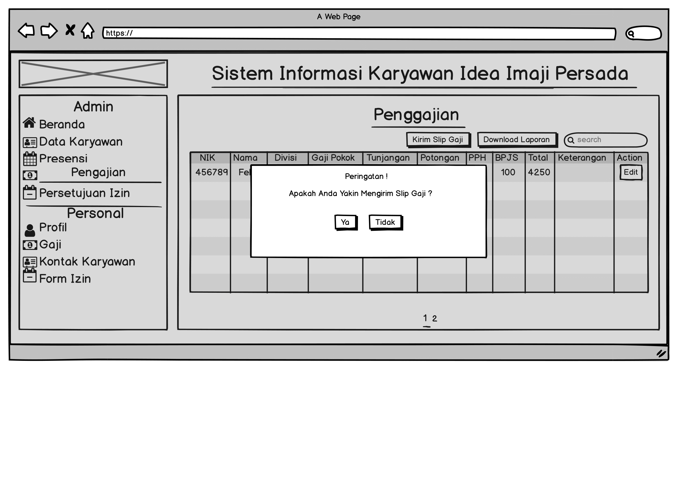
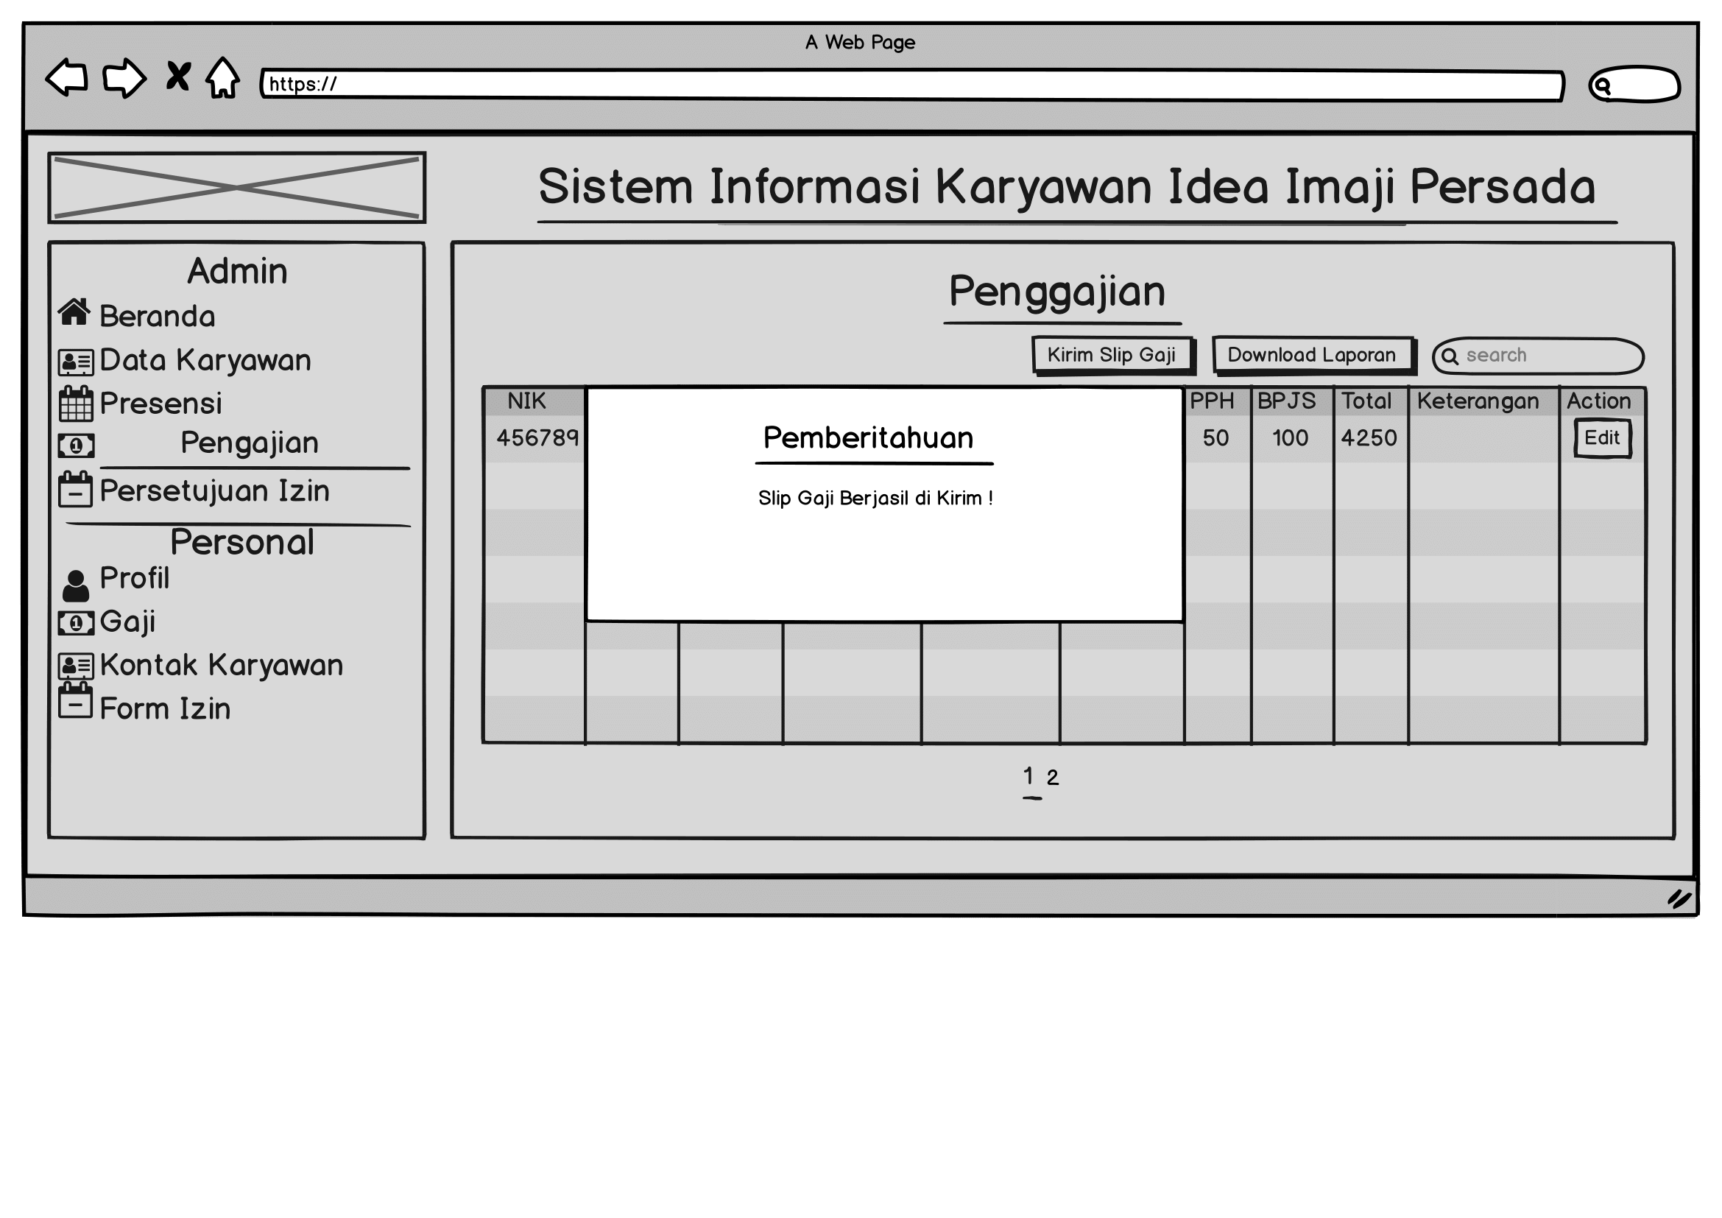
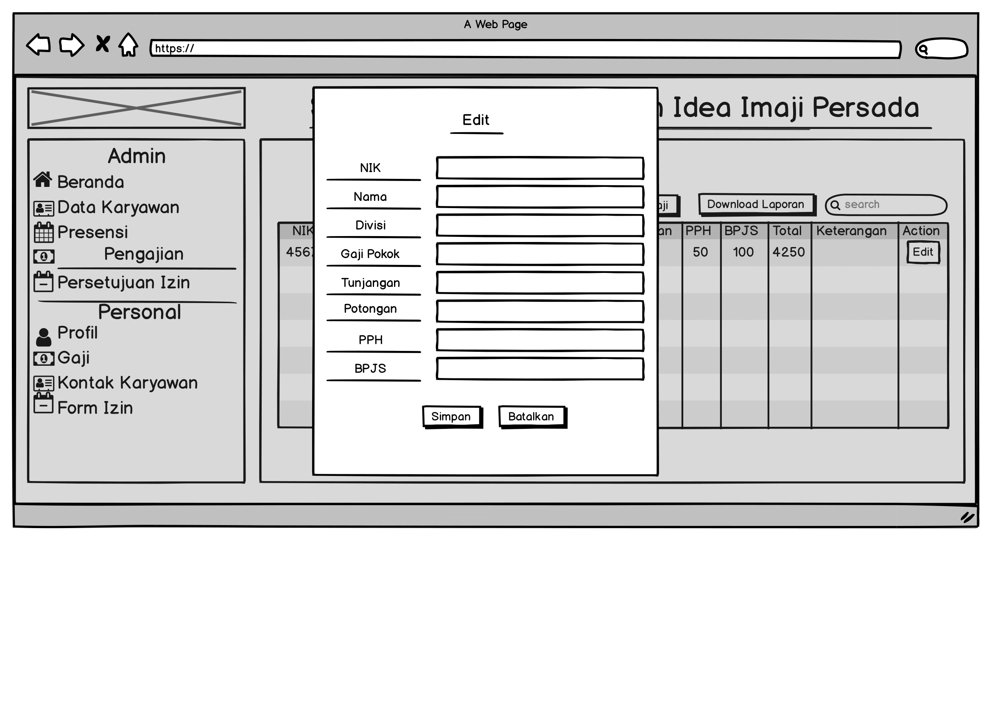
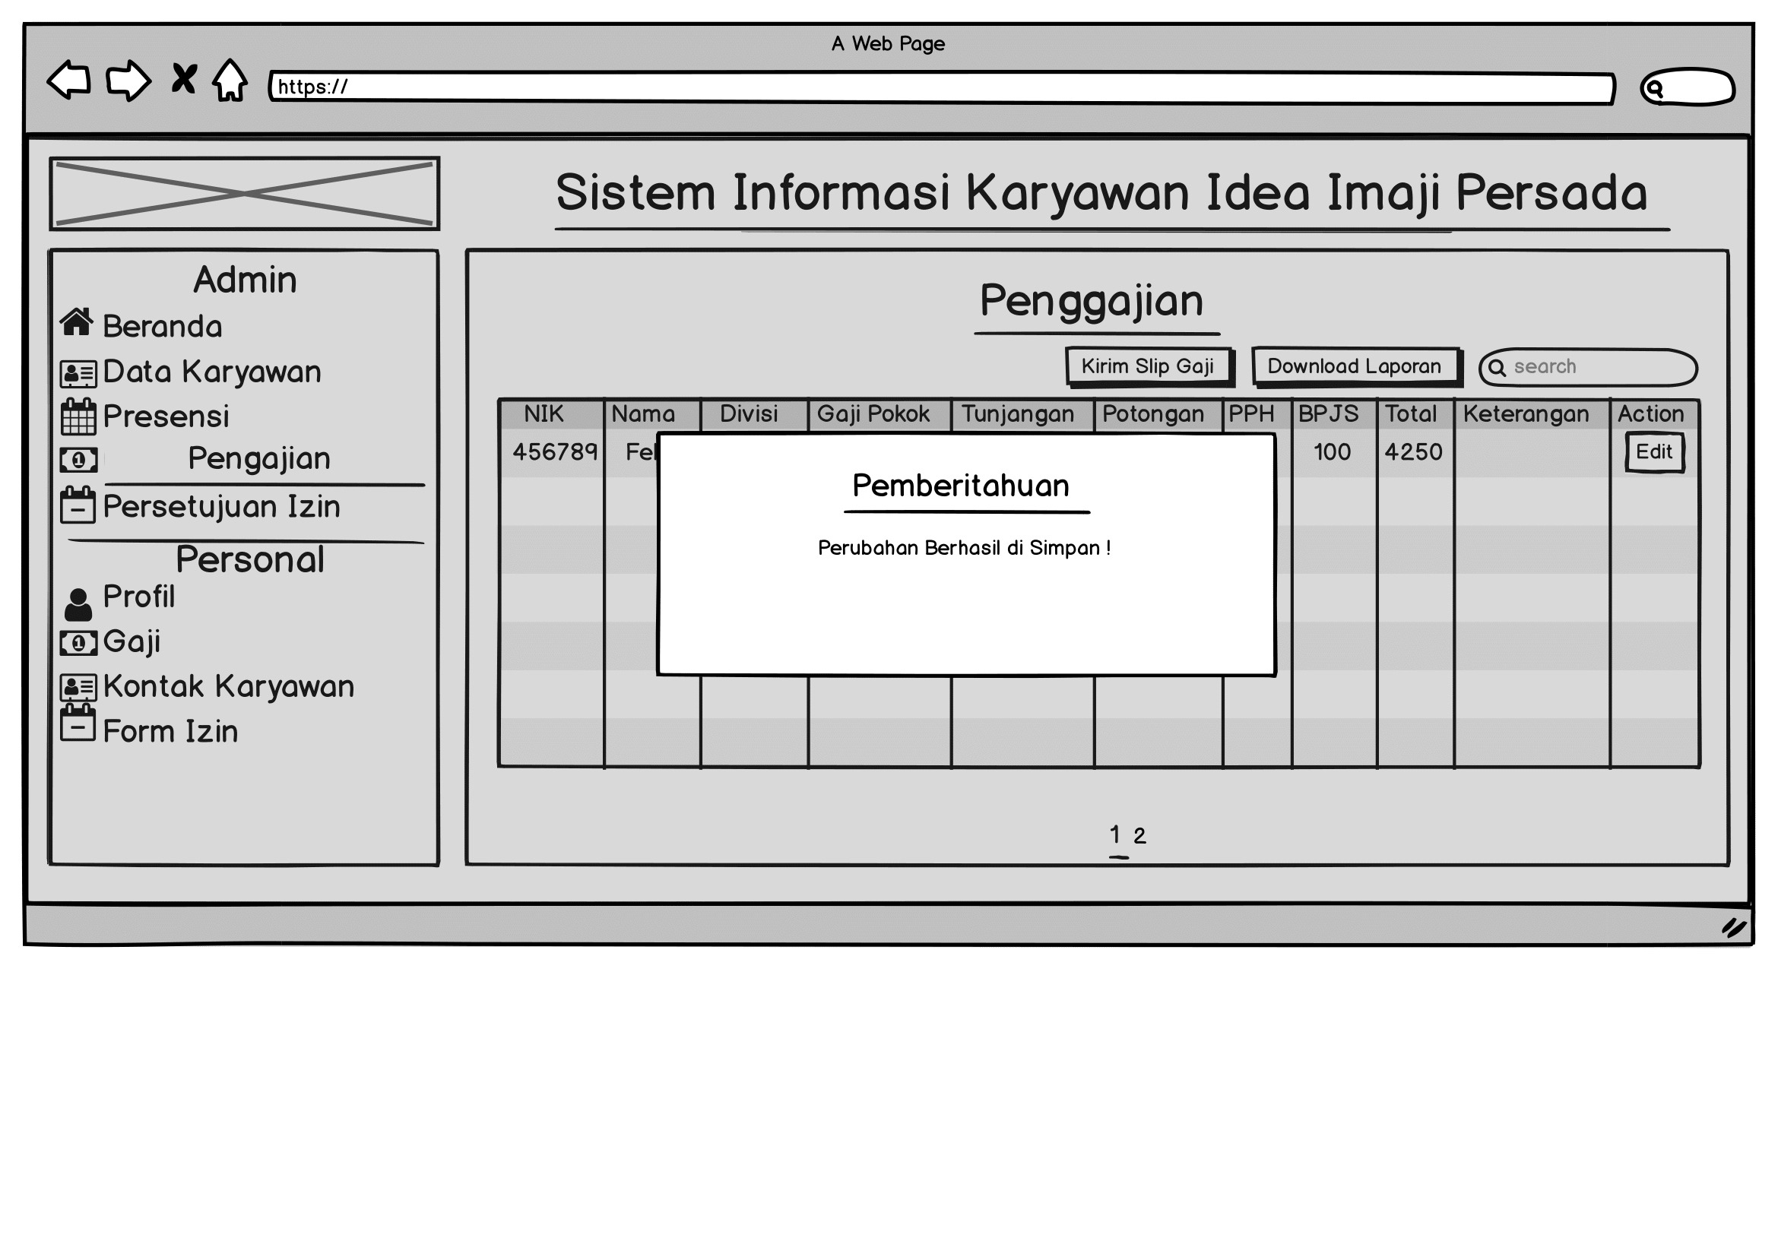
Penggajian

Slide 22
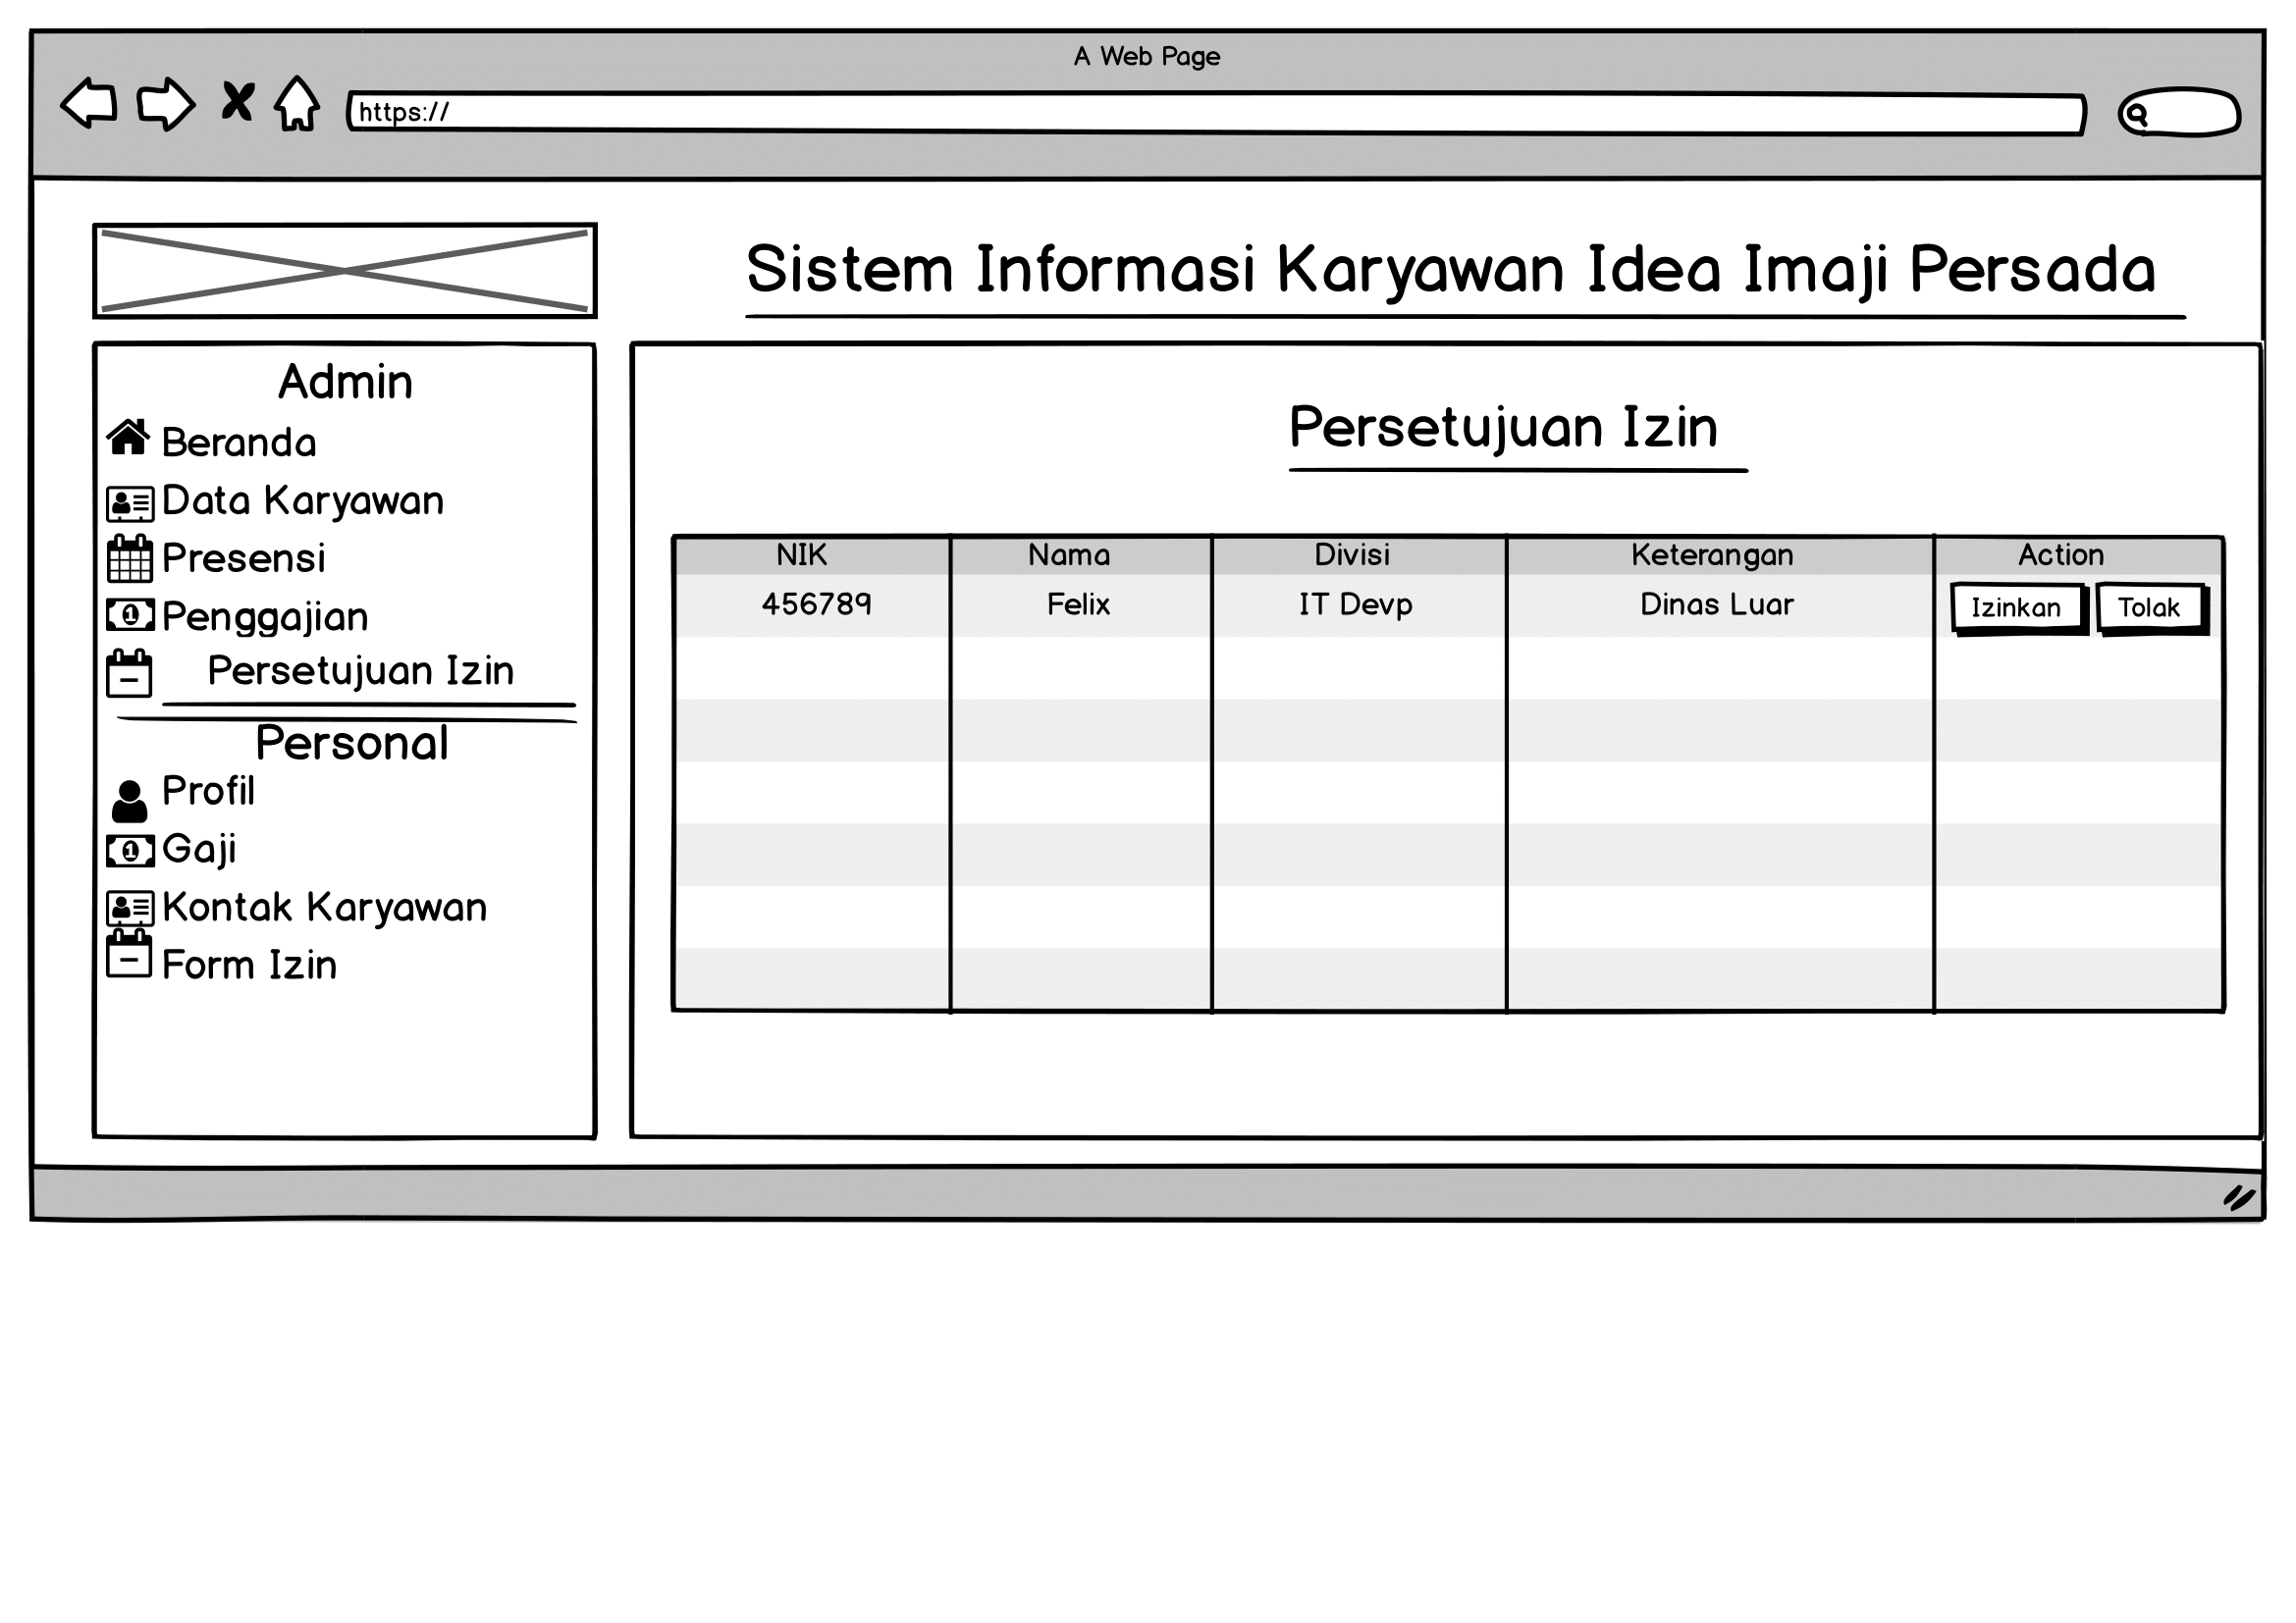
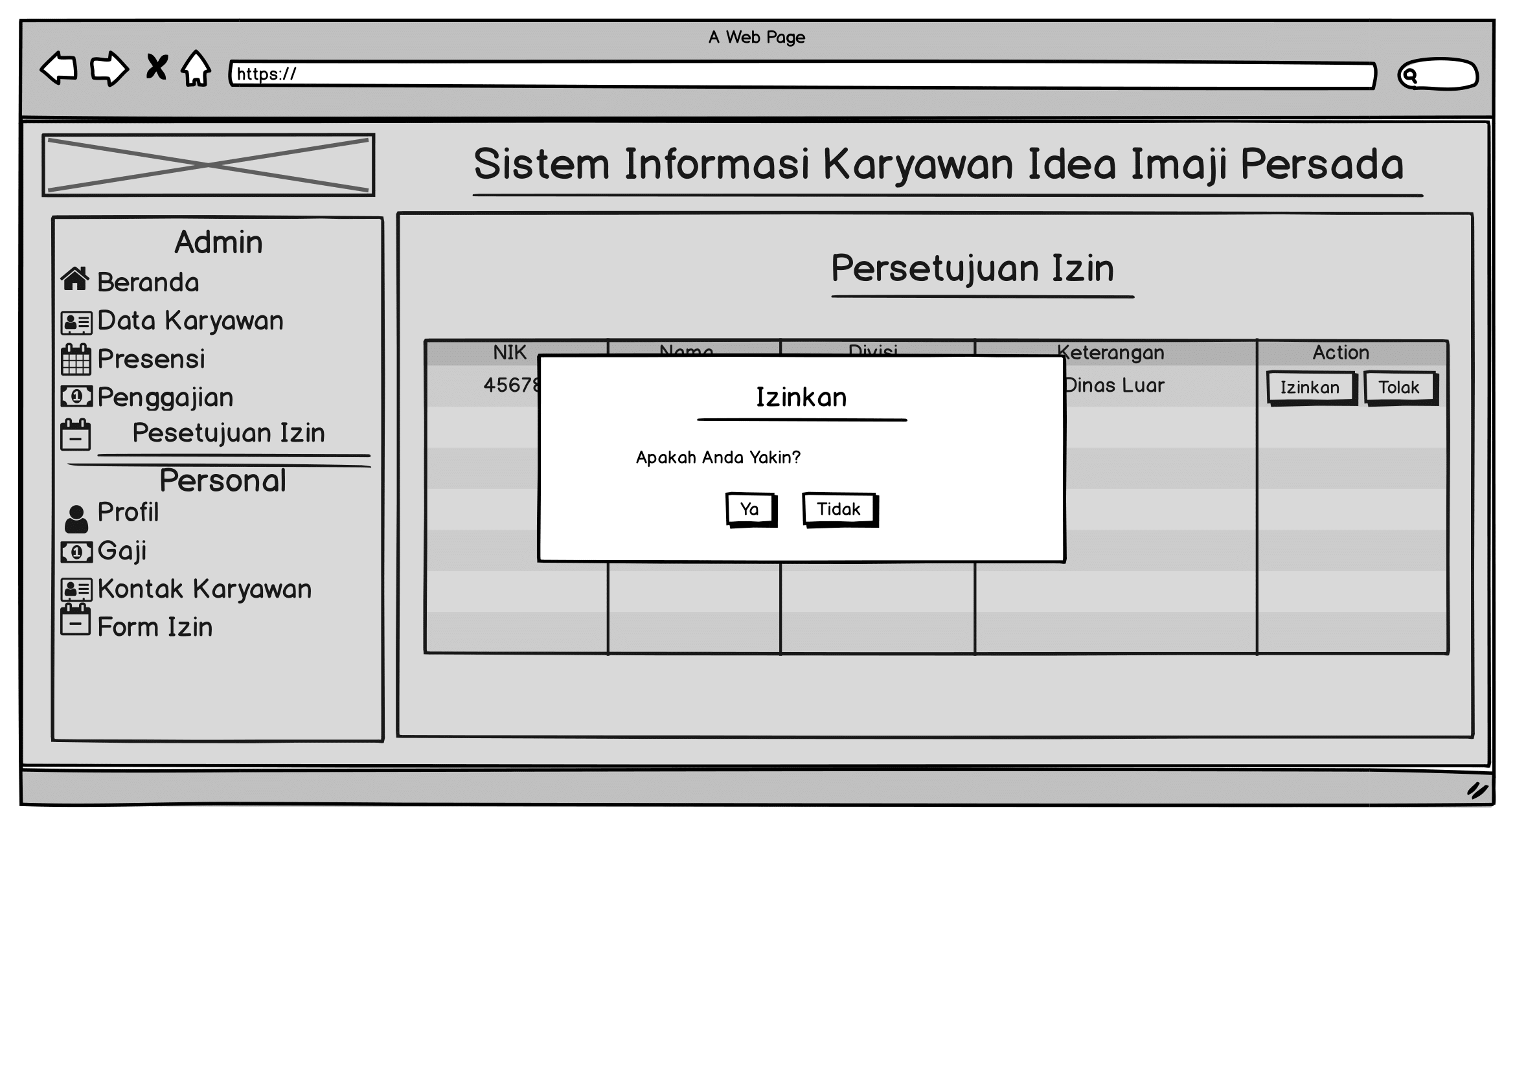
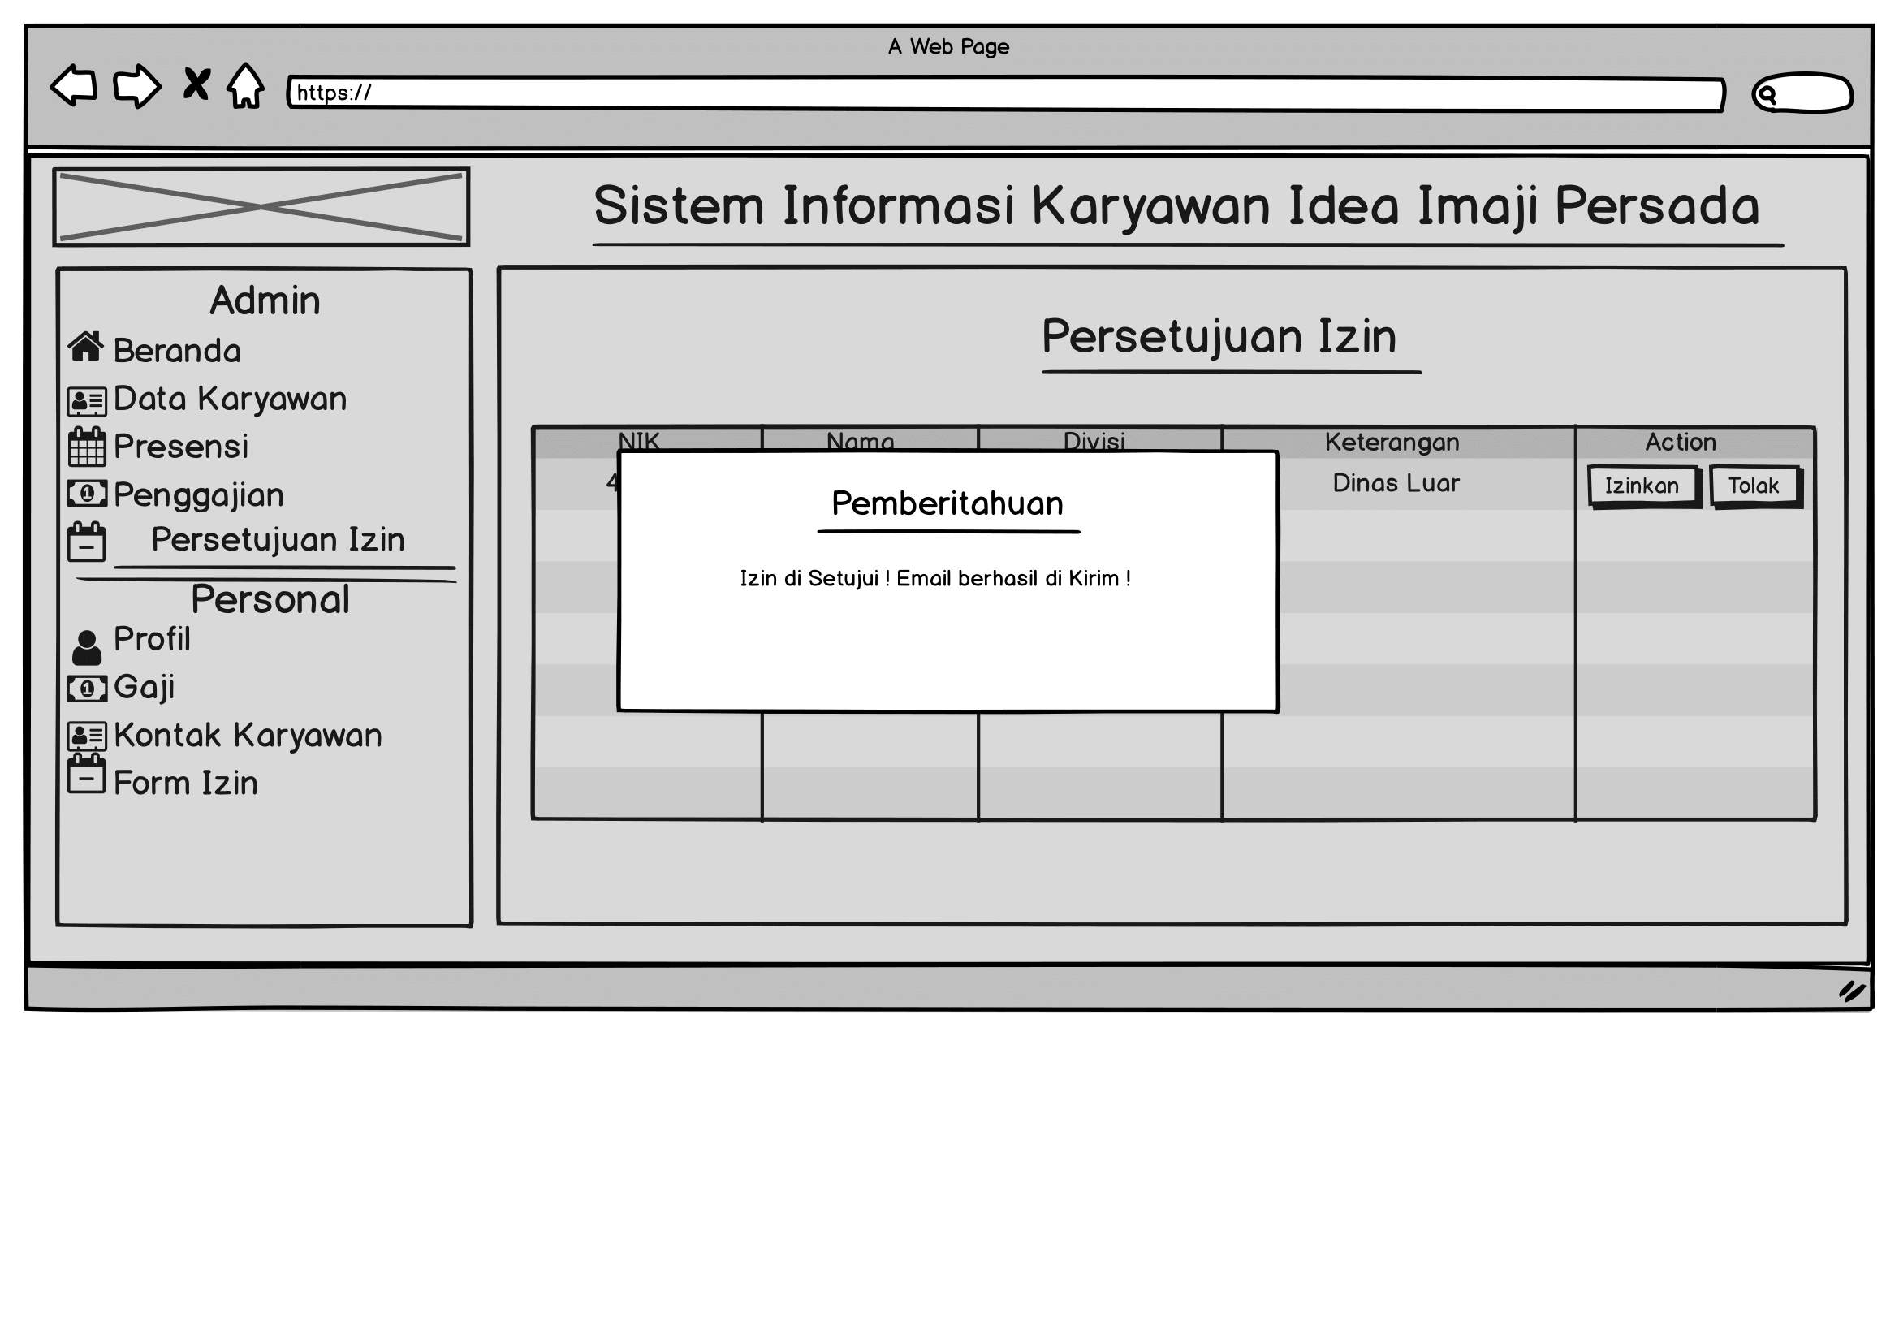
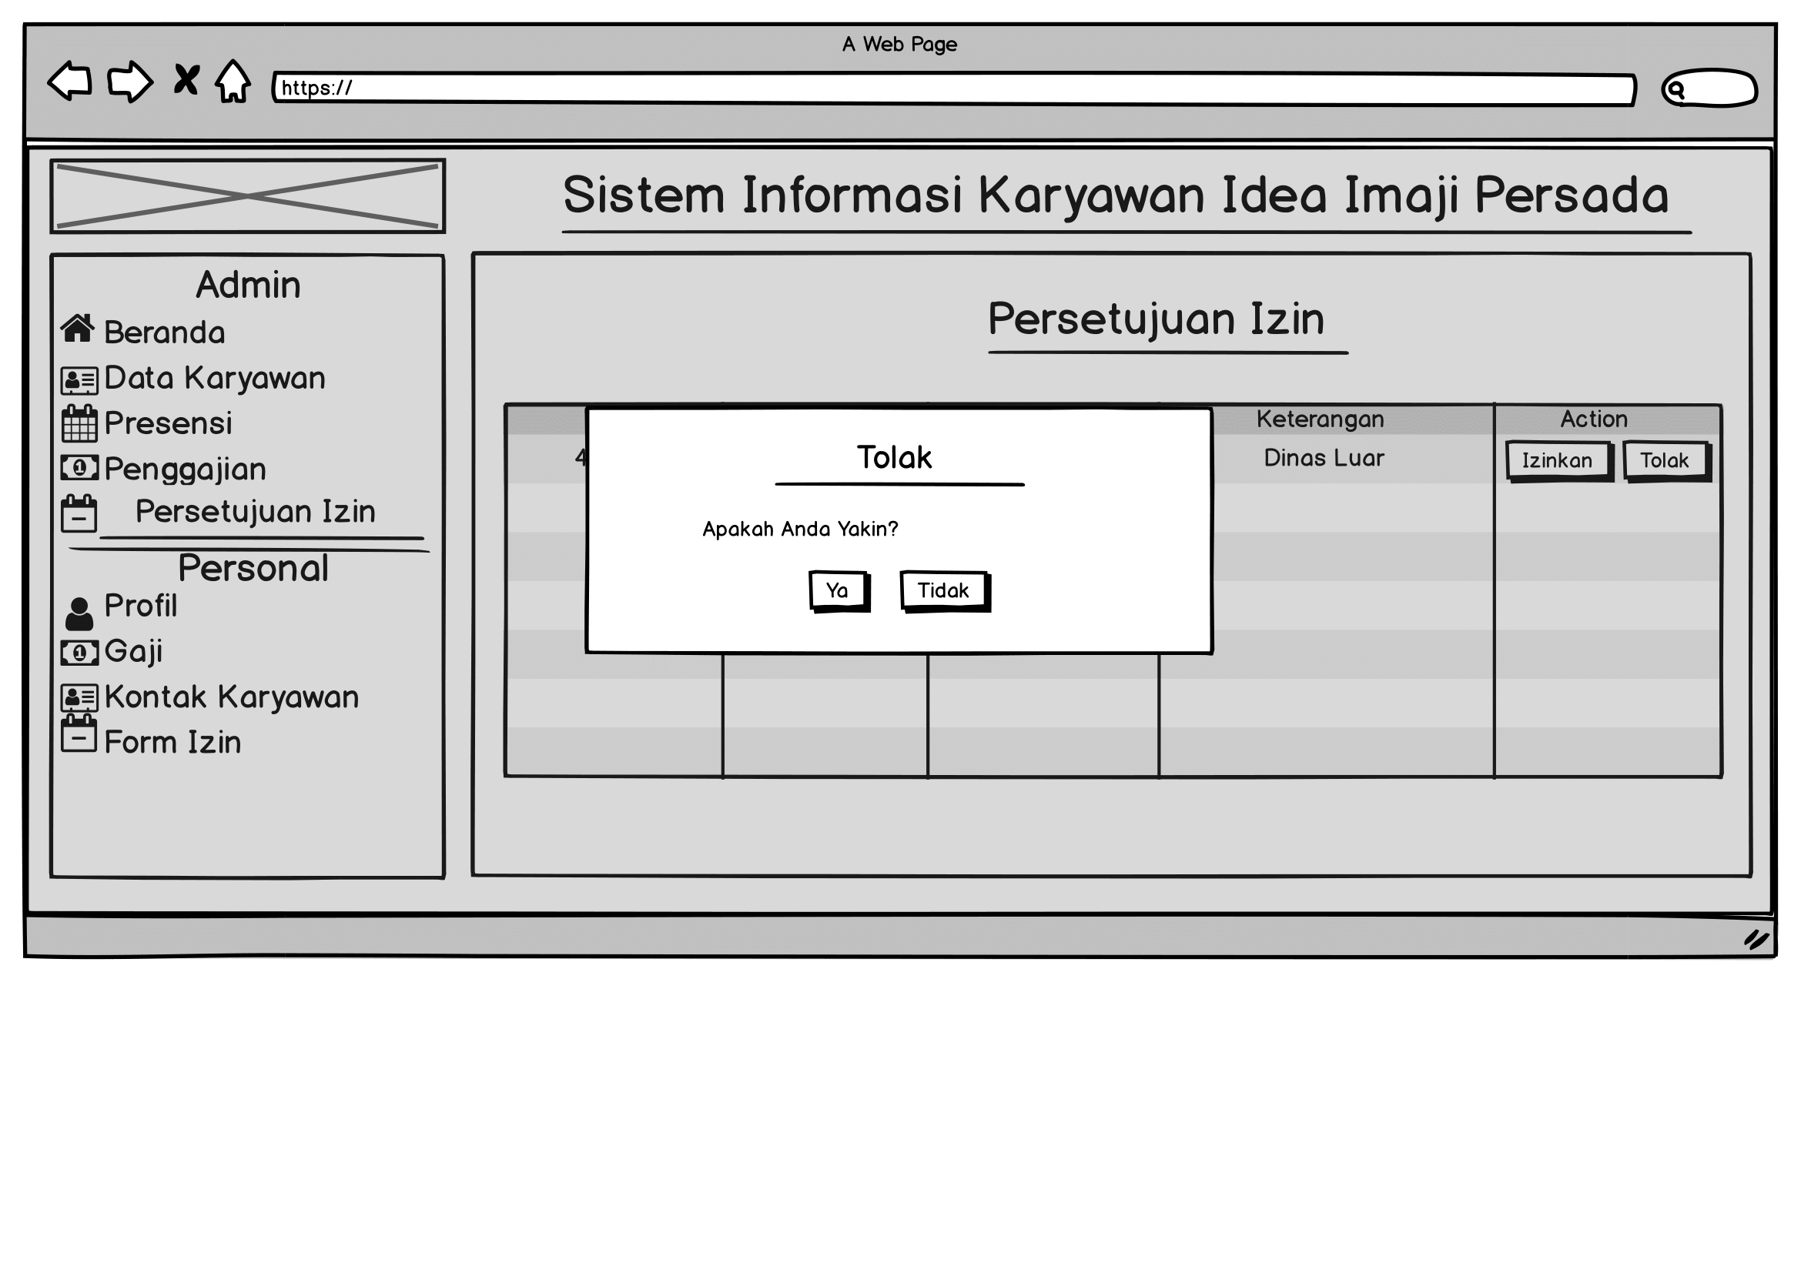
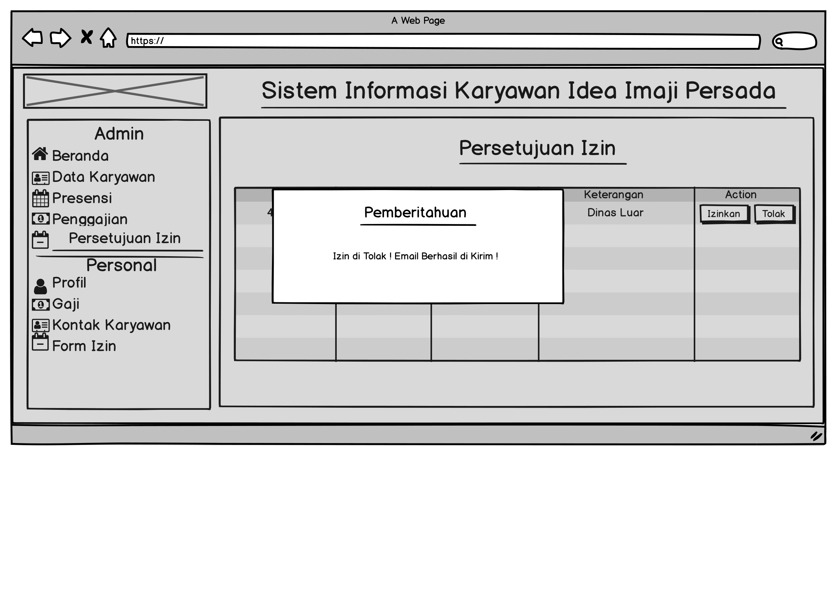
Persetujuan Izin

Slide 23
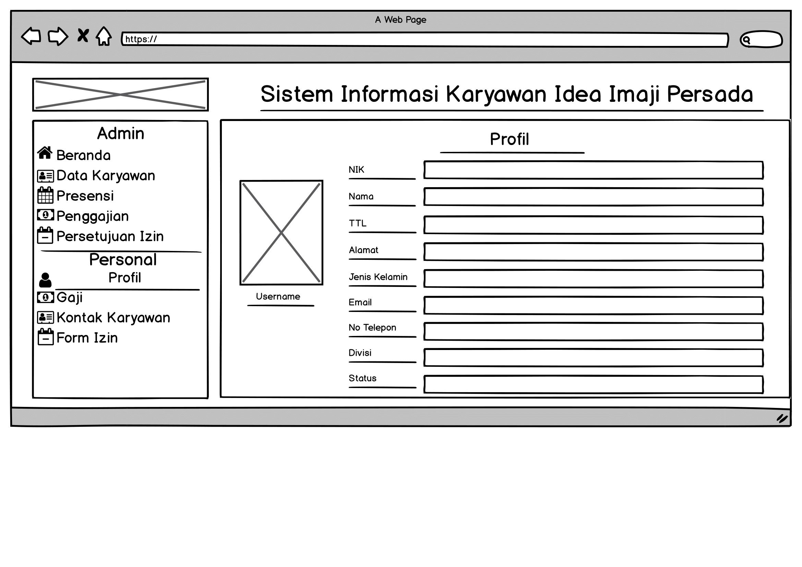
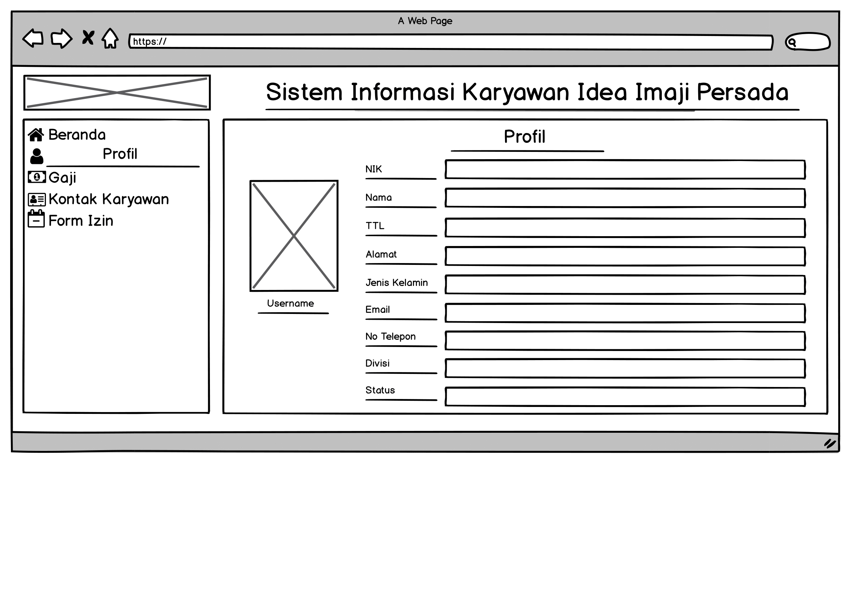
Profil
Admin
Karyawan

Slide 24
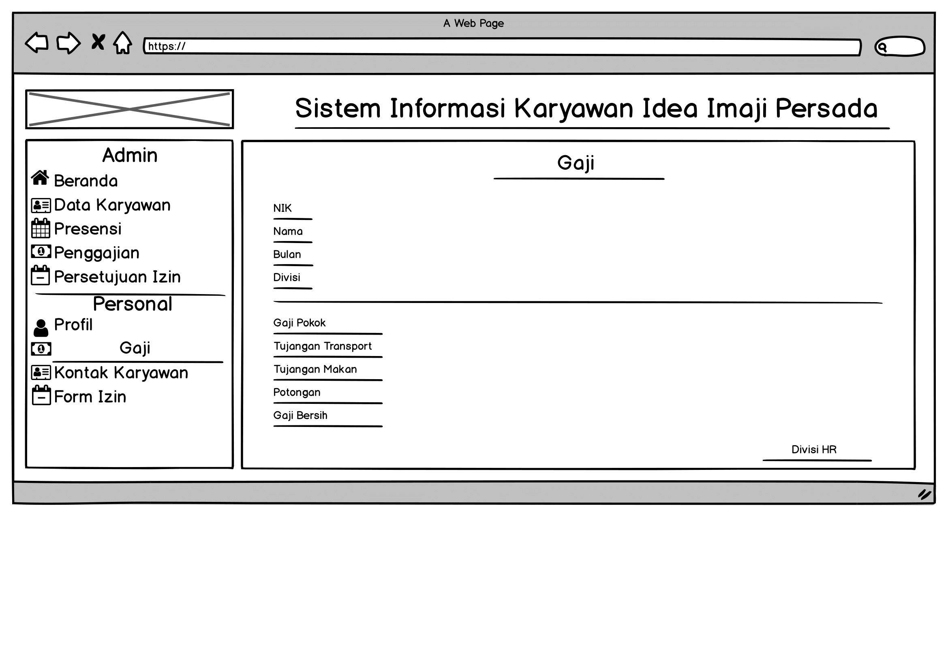
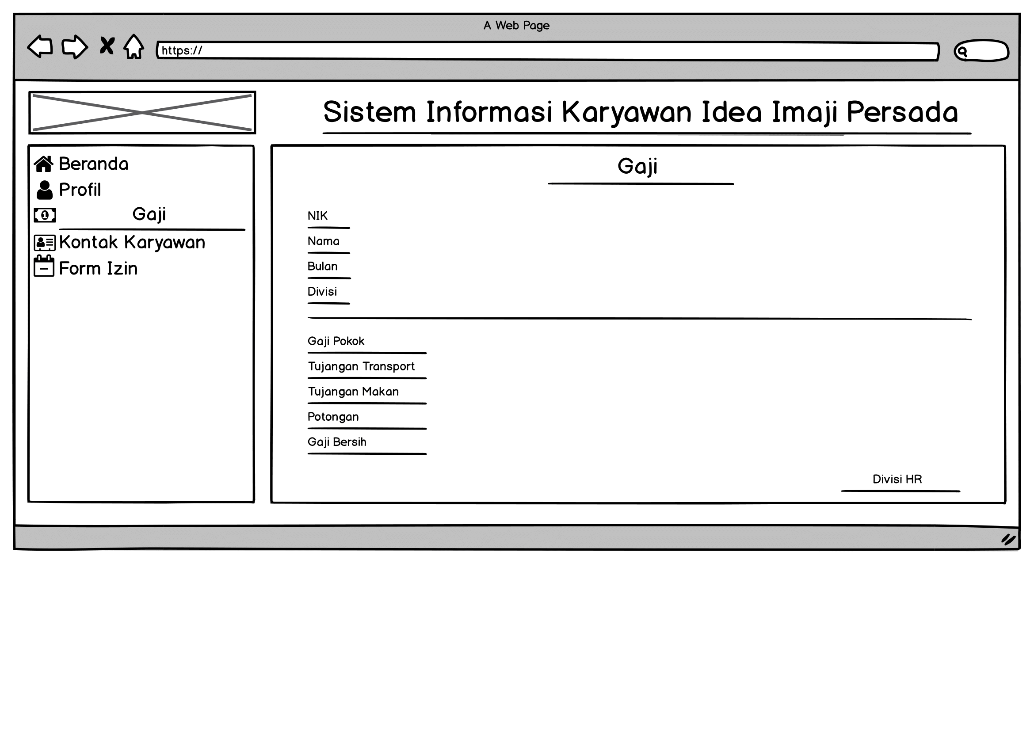
Gaji
Admin
Karyawan

Slide 25
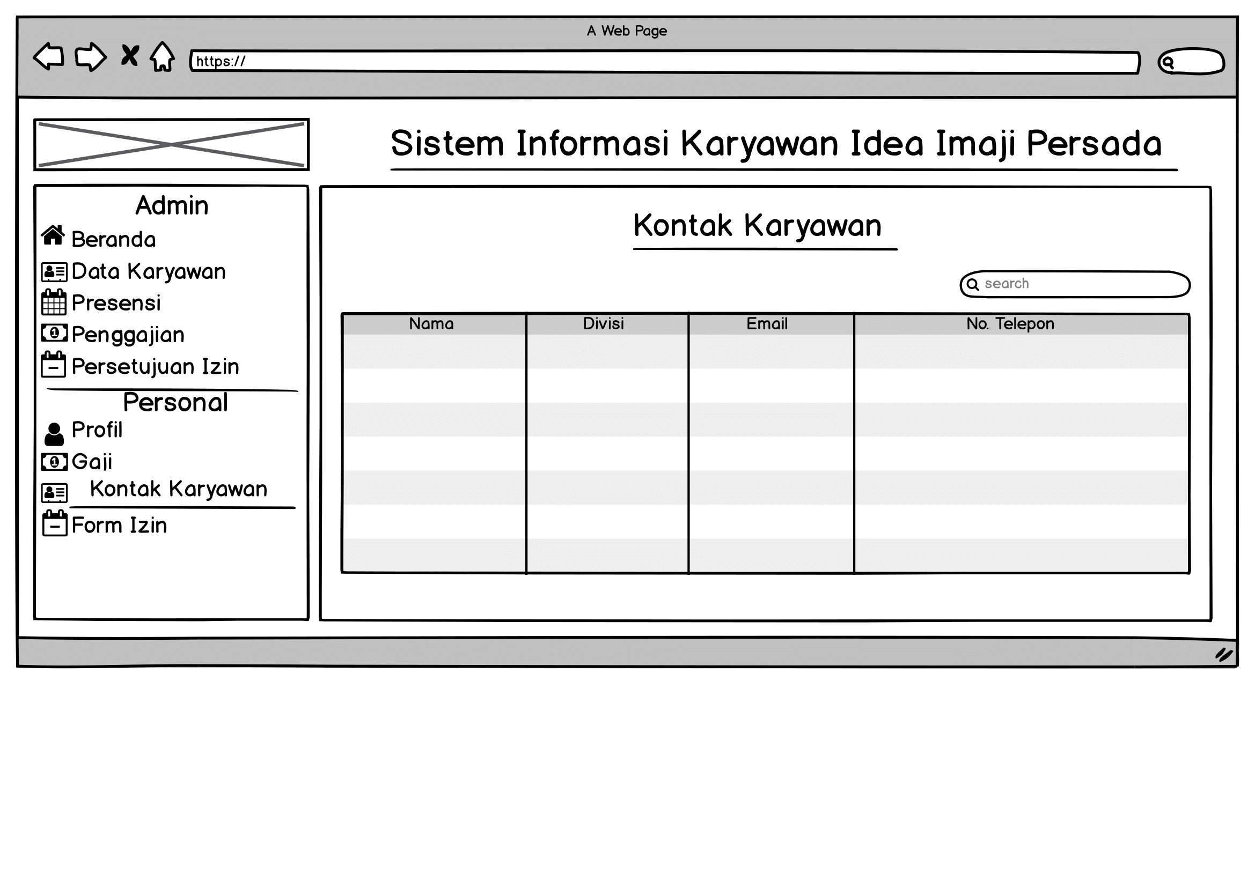
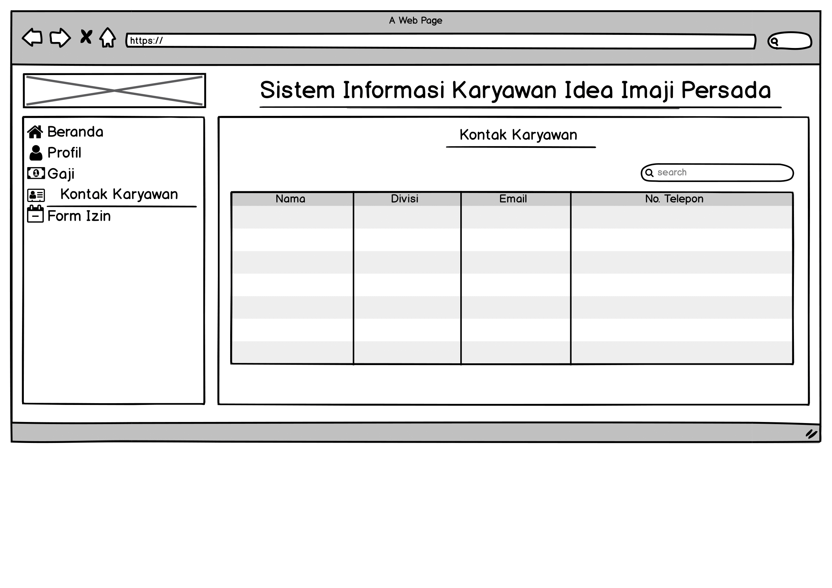
Kontak Karyawan
Admin
Karyawan

Slide 26
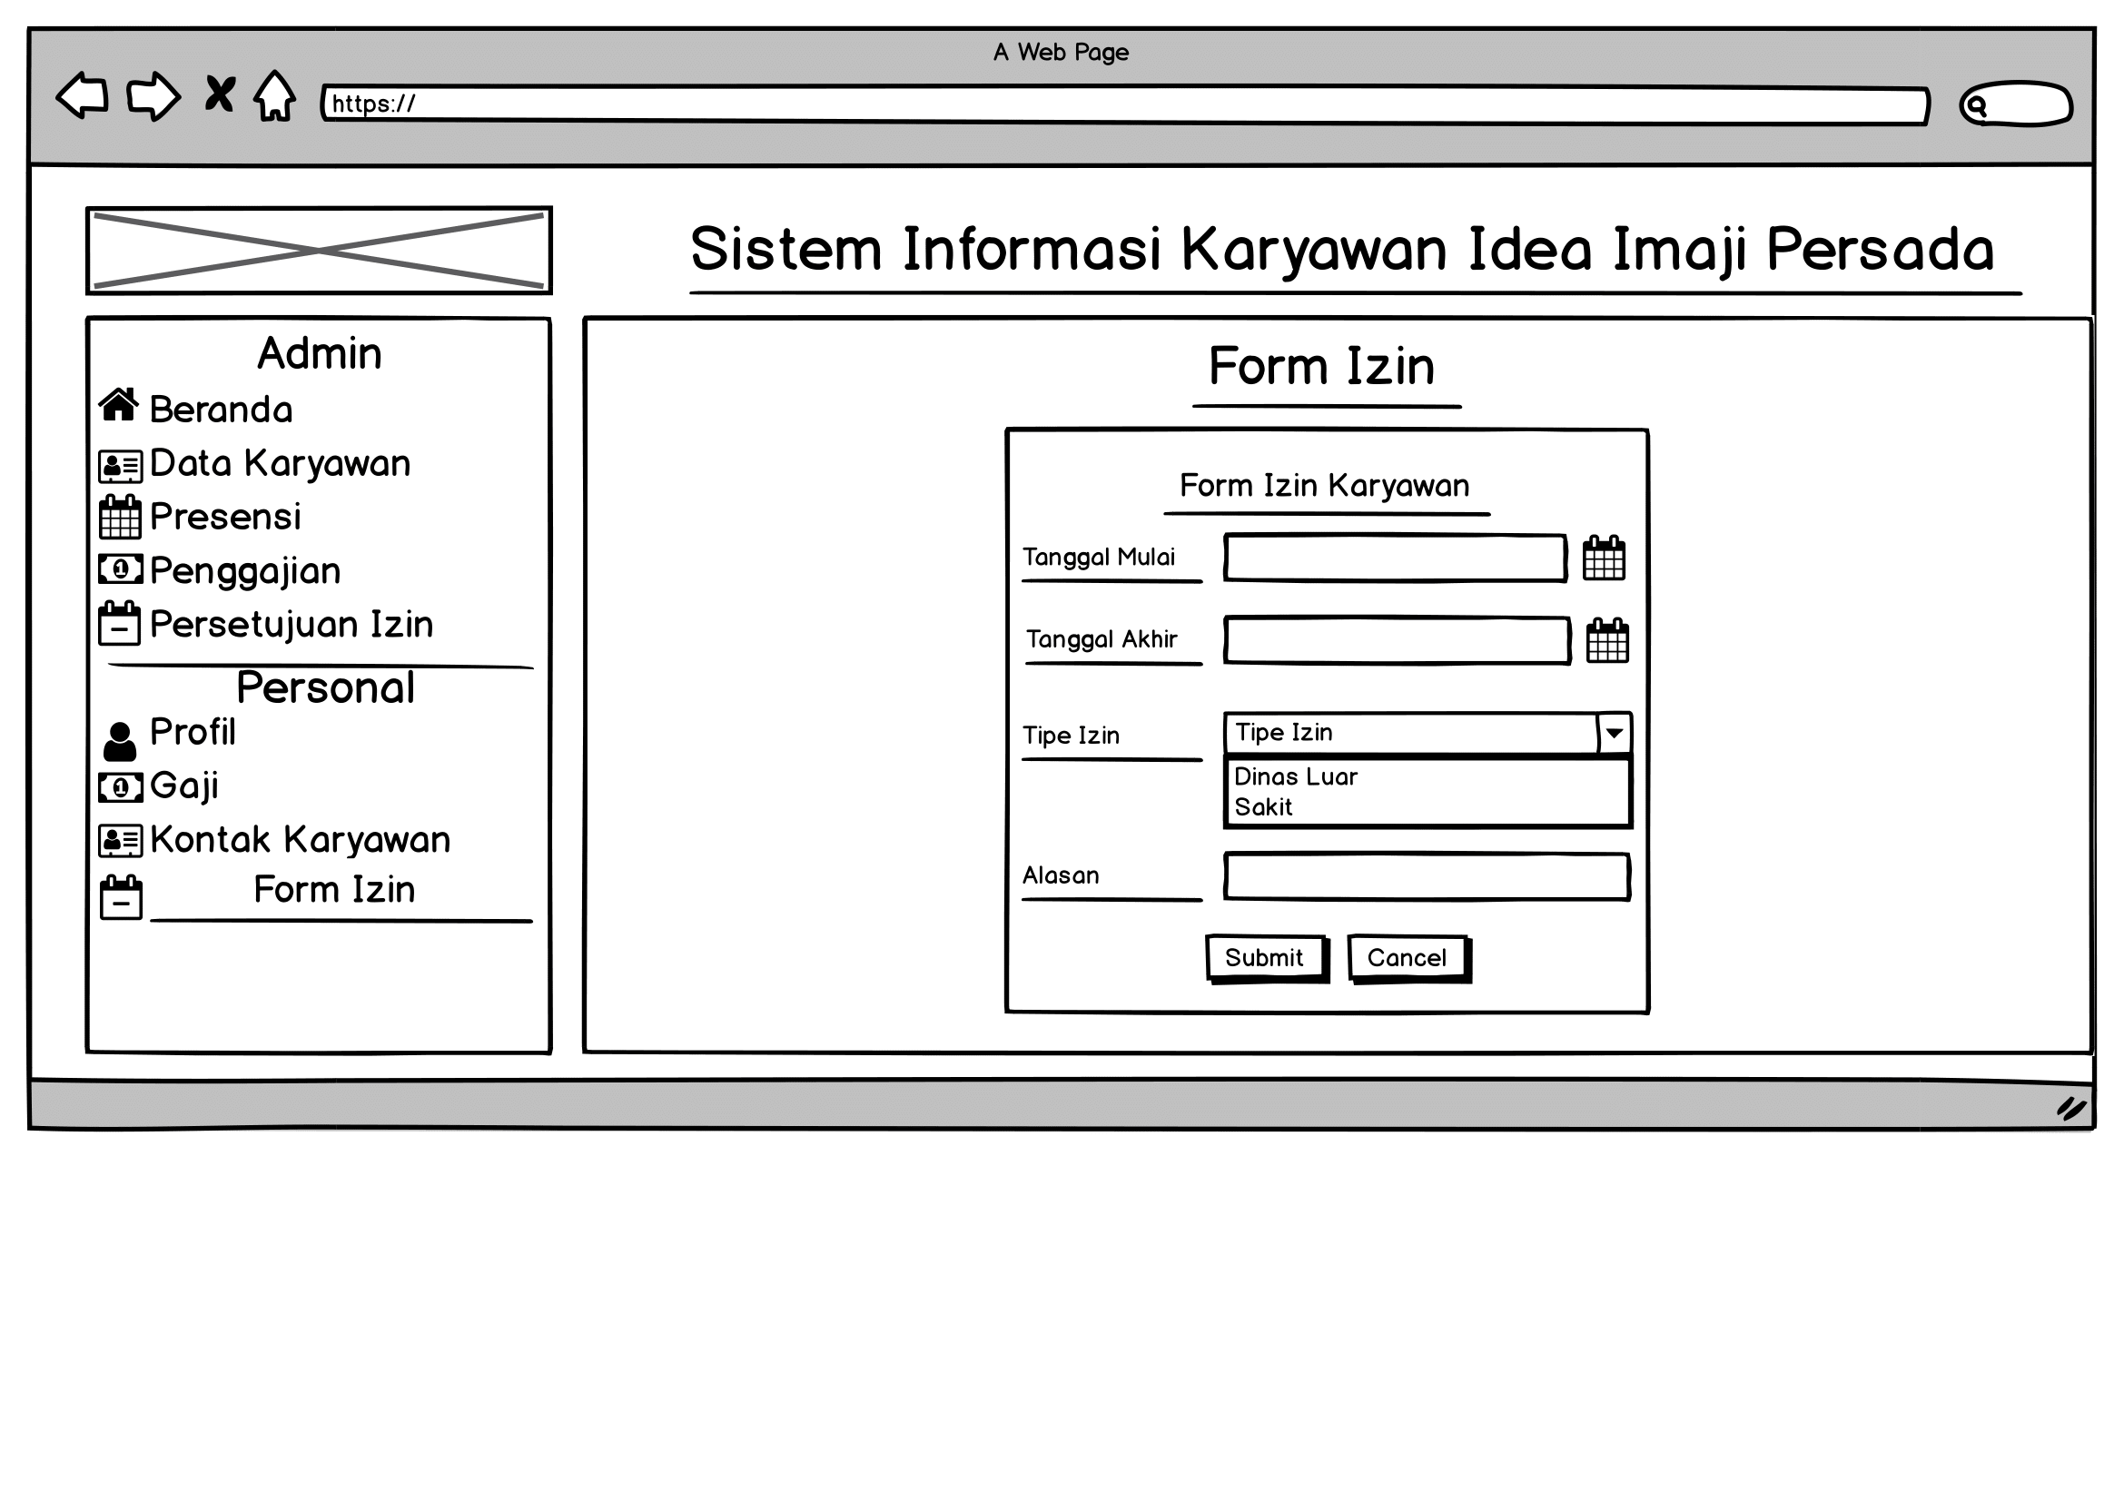
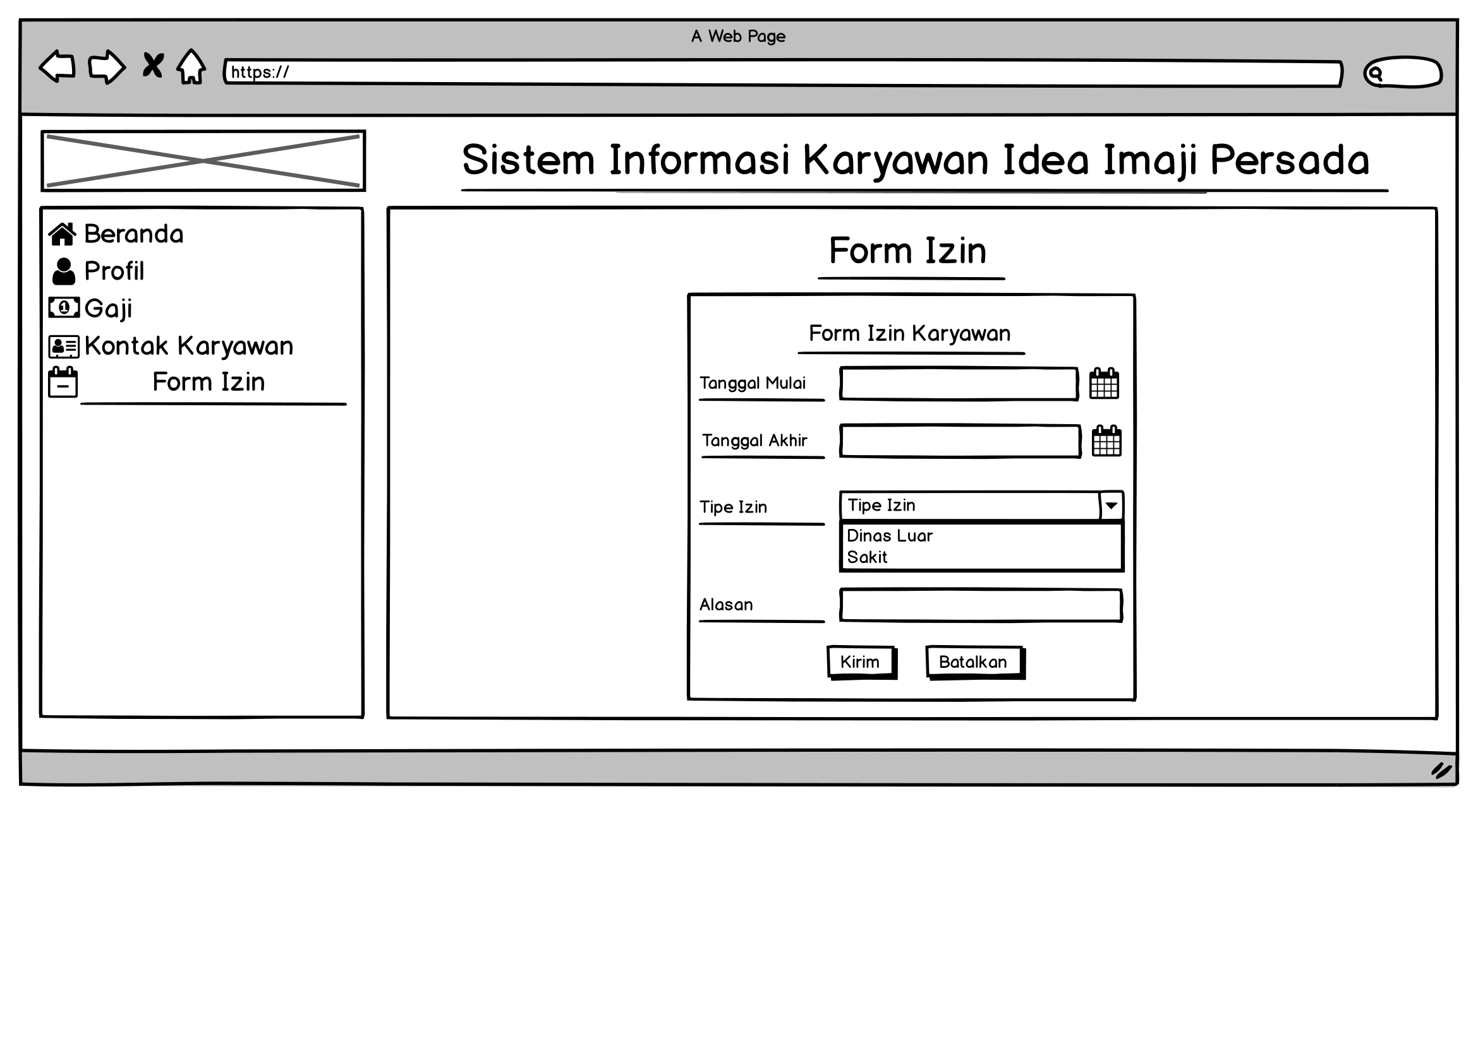
Form Perizinan
Admin
Karyawan

Slide 27
04
TIME FRAME

Slide 28
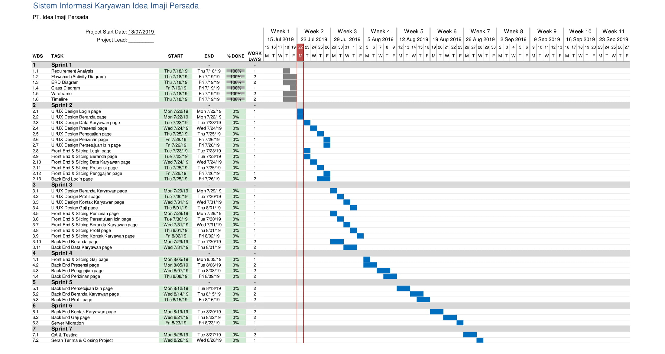

Slide 29
Thank You

Slide 30
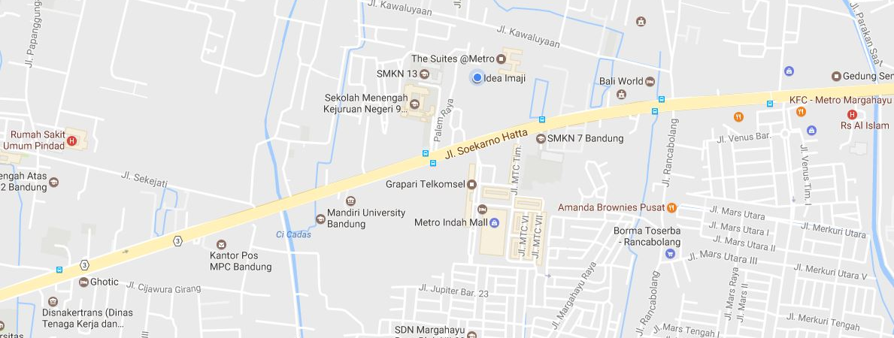
Idea Imaji
Parahyangan Business Park Blok D No. 3
The Suite Metro, Jl. Soekarno Hatta 689B Bandung 40286
Contact Us
Bandung
Phone
Parahyangan Business Park Blok D No. 3
The Suite Metro, Jl. Soekarno Hatta 689B
Bandung 40286
+62 22 87793157
contact@ideaimaji.com
Whether you’re looking for answers, would like to solve a problem, or just want to let us know how we did, you’ll find many ways to contact us right here.
Jakarta
Jl. Tirtasari No. D/2 Utan Kayu
Matraman
Jakarta Timur 13120
Find Me Now

